Slide 1

Hindusthan
College of Arts & Science
An Autonomous College- Affiliated to Bharathiar University
Approved by AICTE and Govt of Tamilnadu
Accredited by NAAC- An ISO Certified Institution
Class: III BSc COSTUME DESIGN &FASHION
SUBJECT:TEXTILE FINISHING TECHNOLOGY

Slide 2
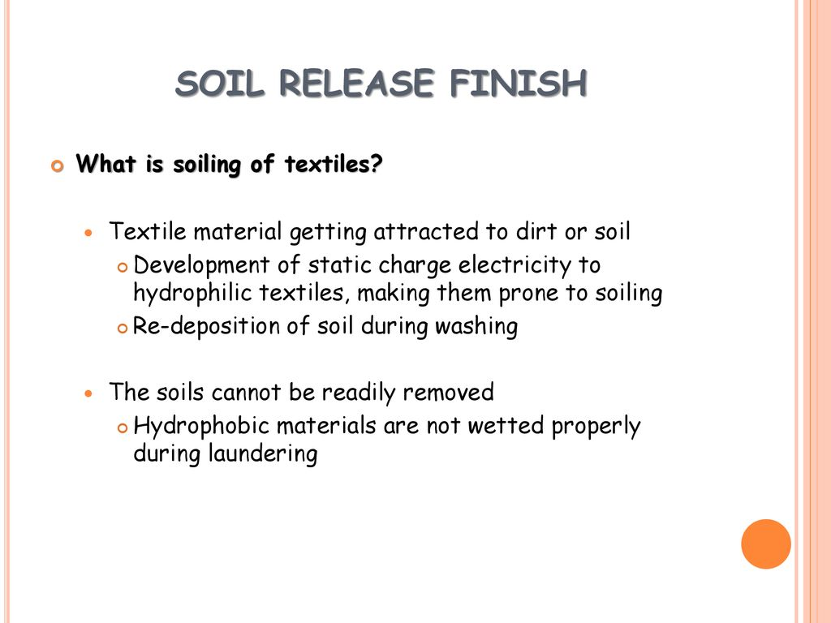
Online Class (Google Meet): Prepared by V.DEEPA Date:01.09.21, Class : III BSc CDF

Slide 3
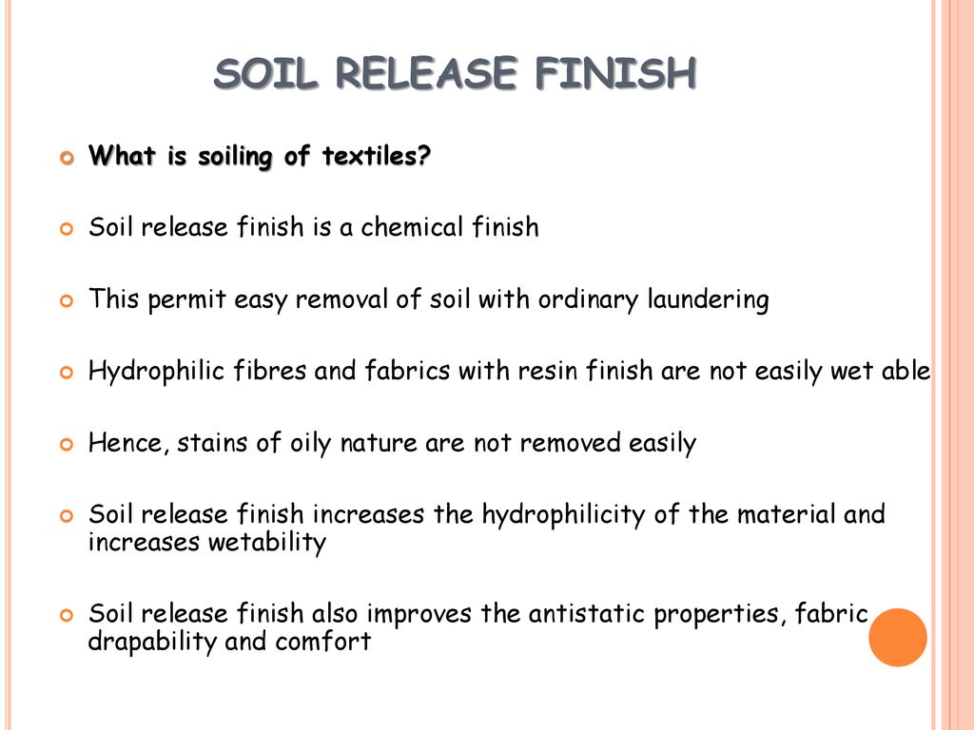
Online Class (Google Meet): Prepared by V.DEEPA Date:01.09.21, Class : III BSc CDF

Slide 4
Online Class (Google Meet): Prepared by V.DEEPA Date:01.09.21, Class : III BSc CDF
Mechanism of Soiling
A fabric gets soiled mainly by three types of mechanism.
1. By mechanical adhesion of soil to the cloth
The soil is adhere to the cloth by direct contact with a soiled surface or by rubbing of the garments against the skin or picking up dirt from liquors or from air.
The fabric construction facilitates such adhesion as the soil gets entrapped in inter fiber and inter yarn spaces or even into the capillary spaces of the fiber where it gets firmly deposited. Also soil which is oily in nature can diffuse into the fiber.

Slide 5
Online Class (Google Meet): Prepared by V.DEEPA Date:01.09.21, Class : III BSc CDF
2. By adhesion by electrical forces
The soil is adhere to the fabric due to attraction of dust particles from air by electrically charged fiber surface.
This phenomenon occurs mainly with synthetic fibers because of their low moisture regain. Positively charged fabric surface is soiled more than negatively charged surface.
3. By redeposition of soil during washing
Which occurs particularly with nylon and polyester fabrics, the redeposition on these Fibers take place because of their oleophilic(strong affinity for oils) nature.
Another aspect of soiling is the effect of time lag between soiling and washing. When a soiled fabric is allowed to lie unwashed for many days, the soil diffuses inside the fiber and it becomes difficult to remove it.

Slide 6
Online Class (Google Meet): Prepared by V.DEEPA Date:01.09.21, Class : III BSc CDF
Factors influencing Soiling
Moisture regain of the fiber is the most important factor that influences soiling. Natural fibers and regenerated cellulose rayons have high moisture regain and have little tendency to accumulate static electricity.
Even if static electricity is generated, it is quickly dissipated to the atmosphere.
Therefore, the problem of soiling and soil removal is not very acute in the case of fibers having high moisture regain.
Synthetic fibers have low moisture regain, therefore they accumulate static electricity which attracts dirt and dust from atmosphere.

Slide 7
Online Class (Google Meet): Prepared by V.DEEPA Date:01.09.21, Class : III BSc CDF
Lower the moisture regain, higher is the attraction of soil. When the moisture regain of the fibers drops below 4%, soiling increases rapidly.
Polyester has the lowest moisture regain (0.4%) among synthetic fibers; therefore it attracts maximum soil. Since these fibers are hydrophobic, they do not swell in water and the removal of soil from the fiber becomes difficult.
In the case of blends with cellulosic fibers, whatever soil is removed from the cellulosic component during washing, gets redeposited on the synthetic fiber because the synthetic fiber being oleophilic, attracts oily matter from the dirty wash waters.

Slide 8
Online Class (Google Meet): Prepared by V.DEEPA Date:01.09.21, Class : III BSc CDF
Electrostatic charge
This is also an important factor which influences soiling. Synthetic fibers accumulate static charge during manufacture and during wear. Charged fibers attract soil from the atmosphere, positively charged fabric attracting more soil than the negatively charged one.
Fabric Structure
Fabric construction, yarn count, twist and the cross section of the fiber influence soiling. Smaller the denier, greater is the tendency to soil. A circular cross sectional fiber retains less soil than one with an irregular cross section.
Higher the twist in the yarn, greater the soil retention. Fabric with protruding fibers assists soiling.

Slide 9
Online Class (Google Meet): Prepared by V.DEEPA Date:01.09.21, Class : III BSc CDF
Loosely woven and open knitted fabrics are more prone to soiling than closely woven fabrics but removal of soil from loosely woven fabrics is easy. Fabrics made from filament yarn do not get soiled as fast as those made from spun yarns.
Particle size of Soil
The smaller the size of the soil particles, grater is the soil retention by the fabric.

Slide 10
Online Class (Google Meet): Prepared by V.DEEPA Date:01.09.21, Class : III BSc CDF
FACTORS AFFECTING SOIL REALESE FINISH
� Nature of the soil
� Kind of fibers
� Nature of textile
� Effects of preparation
� Effects of dyeing and printing
� Effects of other finishes
� Washing conditions

Slide 11
Online Class (Google Meet): Prepared by V.DEEPA Date:01.09.21, Class : III BSc CDF
SOIL RELEASE FINISH
All fibers get soiled but most of them can be washed clean because soap, water or the detergent penetrates the fiber; but this is not so with polyester or polyester blended cotton.
They are hydrophobic and often oleophilic or oil attracting. A soil release finish does not prevent soil from entering the fabric but it simply allows it to leave faster.
It removes soil from the fabric and transfers it to the detergent; it protects the fiber from attack by soiling matter; it prevents redeposition of soil which has been dissolved or dispersed and lastly it prevents dust from being attracted and held by electrical charges on the fabric surface.

Slide 12
Online Class (Google Meet): Prepared by V.DEEPA Date:01.09.21, Class : III BSc CDF
There are two types of soil release treatments available
1. Oleophobic treatments
2. Treatment with hydrophilic substances
In the first group it uses fluorocarbons which are oil repellent, soil resistant and releases oil easily from the textile materials; one such compound is per fluoro-alkyl methacrylate used together with melamine formaldehyde condensate and paraffin wax. Many soil release finishes are applied by pad-dry-cure process.
Thus the fabric may be padded with a mixture of methyl hydrogen polysiloxane and acetyl dimethyl benzyl ammonium chloride together with zinc acetate followed by drying and curing at 160 C for a few minutes. The new breed of soil release finishes confers hydrophilic character to the fiber surface.

Slide 13
Online Class (Google Meet): Prepared by V.DEEPA Date:01.09.21, Class : III BSc CDF
Copolymers of ethyl acrylate with acrylic acid are used for soil release. Permalose T of ICI is applied (1-3%) to polyester and its blends by the pad-dry-cure process; it helps soil removal, prevents redeposition of soil during washing and prevents accumulation of static charges thereby reducing attraction of dust from the air. The finish is fast to washing and dry cleaning.

Slide 14
Online Class (Google Meet): Prepared by V.DEEPA Date:01.09.21, Class : III BSc CDF
Mechanism of Soil Release Finish (DUAL ACTION):
The flouro carbon polymers have the unusual property of being hydrophobic and oleophobic in air and hydrophilic and oil-releasing during the laundering process.
This is called as ‘dual action’ mechanism.
The hydrophilic blocks are shielded by the fluorocarbon segments when dry, presenting a repellent surface.
After immersion in the wash bath, the hydrophilic blocks can swell and actually reverse the interfacial characteristics of the surface, yielding the hydrophilic surface necessary for easy oily soil release during washing.

Slide 15
Online Class (Google Meet): Prepared by V.DEEPA Date:01.09.21, Class : III BSc CDF
So the detergent used during washing can easily penetrate inside the fabric and enhance the soil release.
Typically, these modified fluoro polymers are pad applied to fabrics followed by drying and curing.

Slide 16
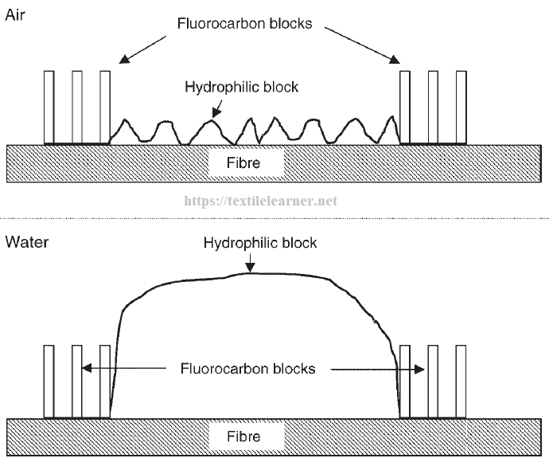
Online Class (Google Meet): Prepared by V.DEEPA Date:01.09.21, Class : III BSc CDF

Slide 17
Online Class (Google Meet): Prepared by V.DEEPA Date:01.09.21, Class : III BSc CDF
PROPERTIES ACHIEVED BY SOIL RELEASE
� Add care to garments.
� Permits better wearability for improved soil release and soil removal.
� Permits relatively easy removal of oil borne stains from permanent press garments.
� Resists redepositing of soil when laundering.
� Aids in making fabric more absorbent.
� Provides greater comfort in hot weather.
� Provides improved anti static properties.

Slide 18
Online Class (Google Meet): Prepared by V.DEEPA Date:01.09.21, Class : III BSc CDF
ADVANTAGES OF SOIL RESISTANT
� It protects the fibre from attack by soiling matter.
� It prevents redeposition of soil which has been dissolved or dispersed
� It prevents dust from being attracted and held by the electrical charges on the fabric surface.
� The finish is fast to washing and dry-cleaning.

Slide 19
Online Class (Google Meet): Prepared by V.DEEPA Date:01.09.21, Class : III BSc CDF
FINISHING AGENTS USED
� FLUOROCARBONS
� FLUOROCHEMICALS
� PYRIDINUM COMPOUNDS
� RESINS
� SILICONE
� TRIAZINE COMPOUNDS
� WAX AND ITS DERIVATIVES

Slide 20
Online Class (Google Meet): Prepared by V.DEEPA Date:01.09.21, Class : III BSc CDF
MCQ - 1
https://docs.google.com/forms/d/e/1FAIpQLSf-qNCgnr5PG9IHDxnQQc2efvc7Sxd4ak-dcYhD0blfu7K_zw/viewform?usp=sf_link

Slide 21
Online Class (Google Meet): Prepared by V.DEEPA Date:01.09.21, Class : III BSc CDF
MCQ - 2
https://docs.google.com/forms/d/e/1FAIpQLSe564nskt0uu97Cp6VN8D6bvFoTJb0daGABRU2HcyWlvgeviw/viewform?usp=sf_link

