Slide 1

Hindusthan
College of Arts & Science
An Autonomous College- Affiliated to Bharathiar University
Approved by AICTE and Govt of Tamilnadu
Accredited by NAAC- An ISO Certified Institution
Class: III BSc COSTUME DESIGN &FASHION
SUBJECT:TEXTILE FINISHING TECHNOLOGY

Slide 2
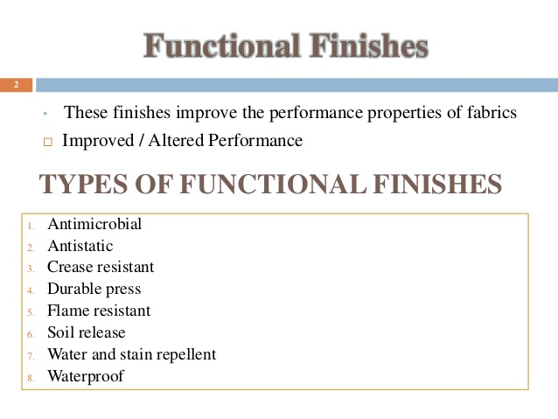
Online Class (Google Meet): Prepared by V.DEEPA Date:11.08.2021, Class : III BSc CDF

Slide 3

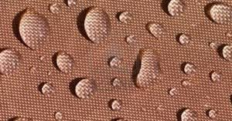
Online Class (Google Meet): Prepared by V.DEEPA Date:11.08.2021, Class : III BSc CDF

Slide 4
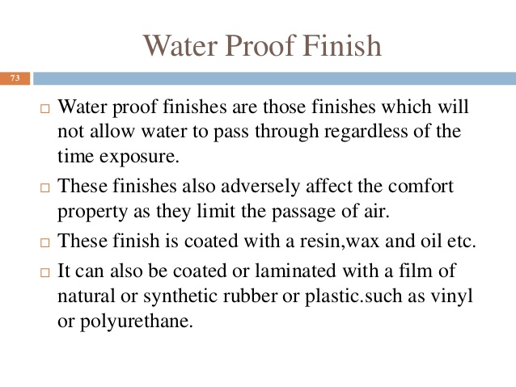
Online Class (Google Meet): Prepared by V.DEEPA Date:11.08.2021, Class : III BSc CDF

Slide 5
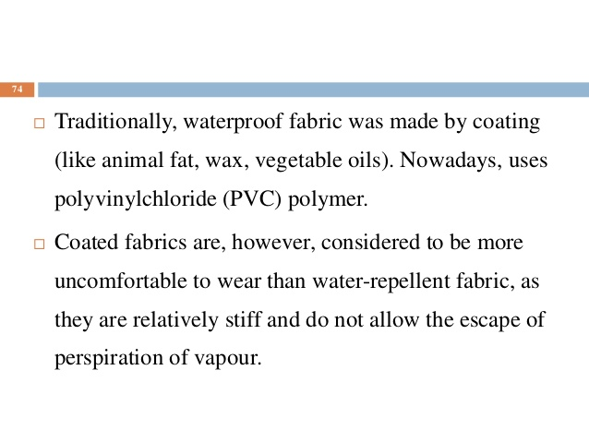
Online Class (Google Meet): Prepared by V.DEEPA Date:11.08.2021, Class : III BSc CDF

Slide 6
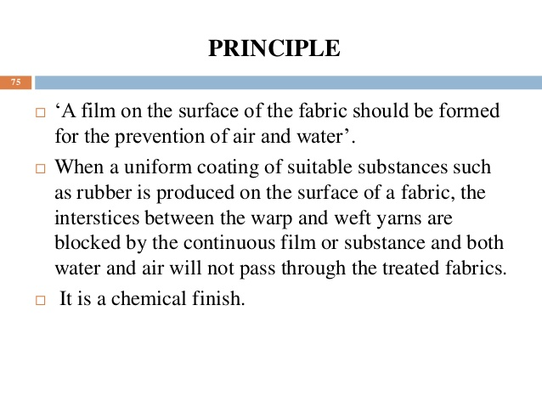
Online Class (Google Meet): Prepared by V.DEEPA Date:11.08.2021, Class : III BSc CDF

Slide 7
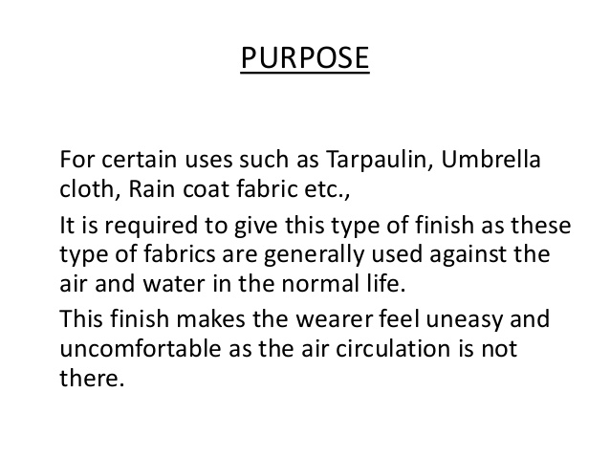
Online Class (Google Meet): Prepared by V.DEEPA Date:11.08.2021, Class : III BSc CDF

Slide 8
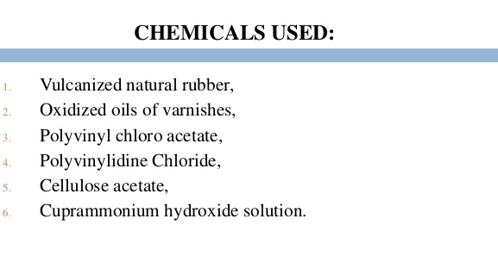
Online Class (Google Meet): Prepared by V.DEEPA Date:11.08.2021, Class : III BSc CDF

Slide 9
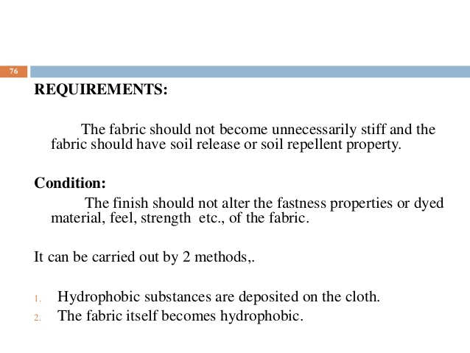
Online Class (Google Meet): Prepared by V.DEEPA Date:11.08.2021, Class : III BSc CDF

Slide 10
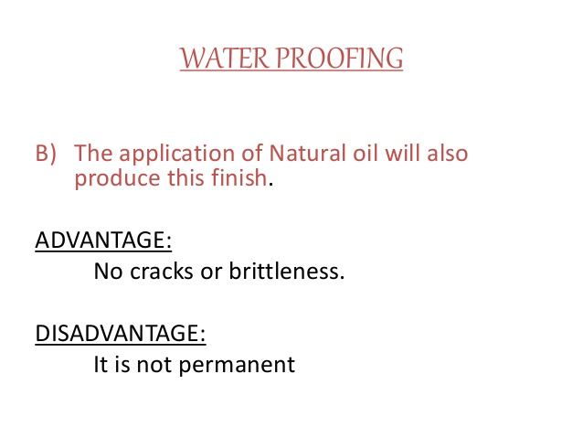
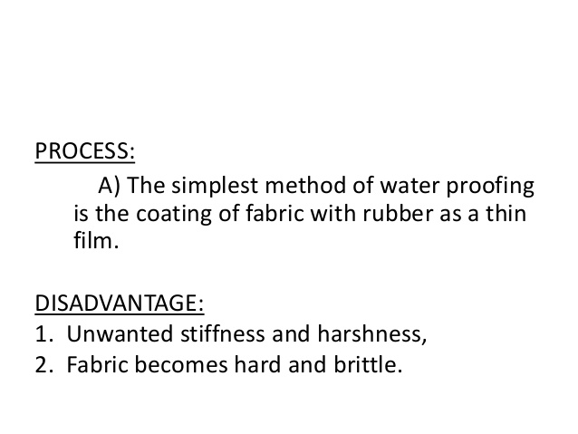
Online Class (Google Meet): Prepared by V.DEEPA Date:11.08.2021, Class : III BSc CDF

Slide 11
Online Class (Google Meet): Prepared by V.DEEPA Date:11.08.2021, Class : III BSc CDF

Slide 12
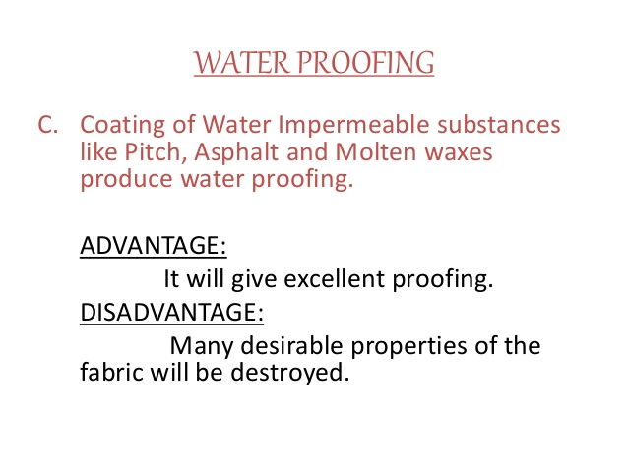
Online Class (Google Meet): Prepared by V.DEEPA Date:11.08.2021, Class : III BSc CDF

Slide 13
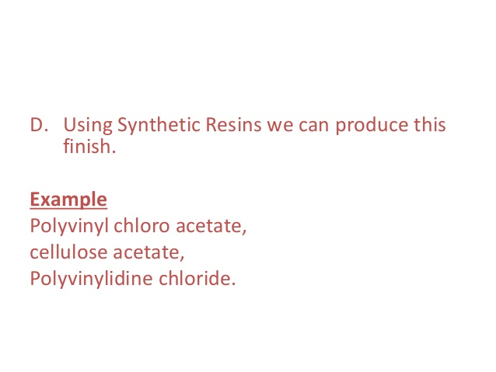
Online Class (Google Meet): Prepared by V.DEEPA Date:11.08.2021, Class : III BSc CDF

Slide 14
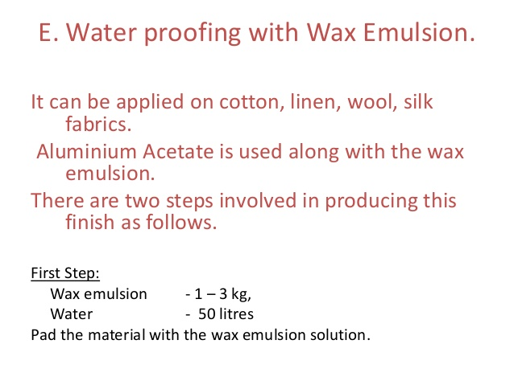
Online Class (Google Meet): Prepared by V.DEEPA Date:11.08.2021, Class : III BSc CDF

Slide 15
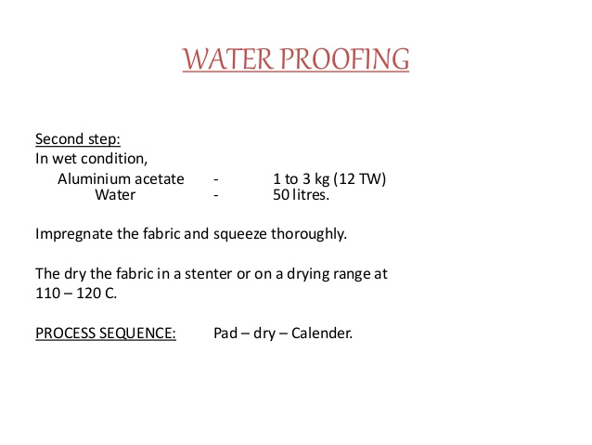
Online Class (Google Meet): Prepared by V.DEEPA Date:11.08.2021, Class : III BSc CDF

Slide 16
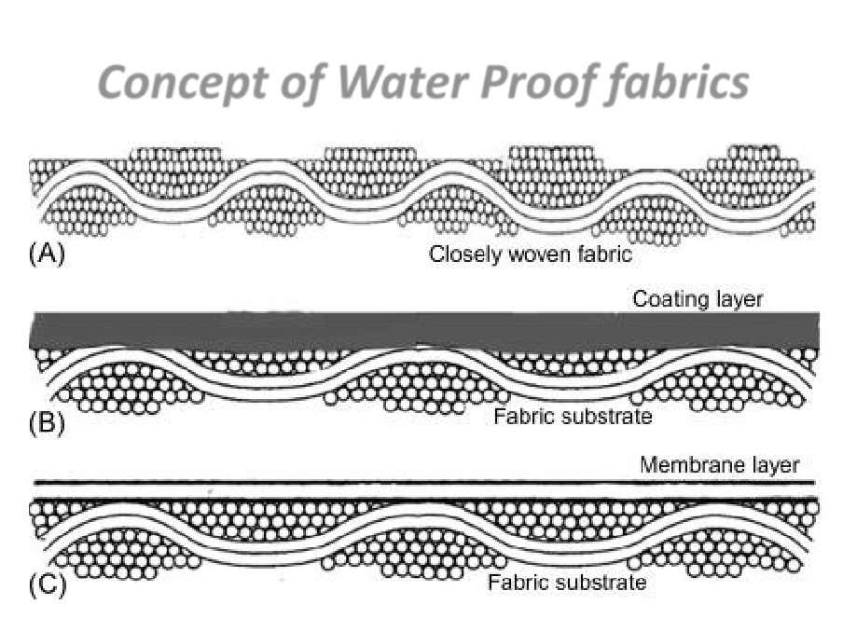
Online Class (Google Meet): Prepared by V.DEEPA Date:11.08.2021, Class : III BSc CDF

Slide 17
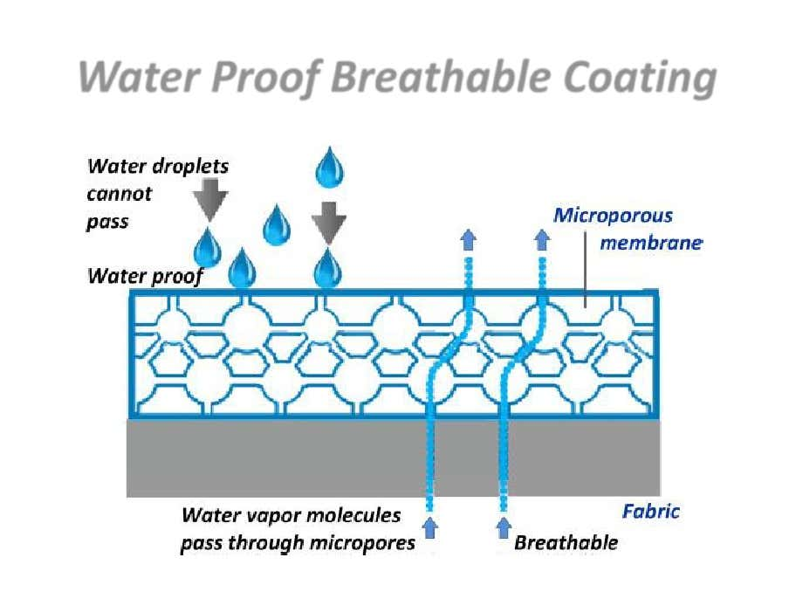
Online Class (Google Meet): Prepared by V.DEEPA Date:11.08.2021, Class : III BSc CDF

Slide 18
Online Class (Google Meet): Prepared by V.DEEPA Date:11.08.2021, Class : III BSc CDF
MCQ
https://docs.google.com/forms/d/e/1FAIpQLSc7bj7l13Sghe0SawtT-QROIaIxCDWLUxPqAZsdJz-_C78jaw/viewform?usp=sf_link

