Slide 1

Hindusthan
College of Arts & Science
An Autonomous College- Affiliated to Bharathiar University
Approved by AICTE and Govt of Tamilnadu
Accredited by NAAC- An ISO Certified Institution
Class: III BSc COSTUME DESIGN &FASHION
SUBJECT:TEXTILE FINISHING TECHNOLOGY

Slide 2
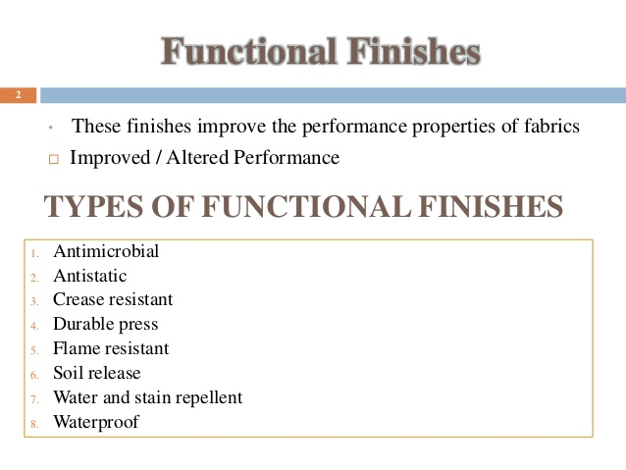

Slide 3
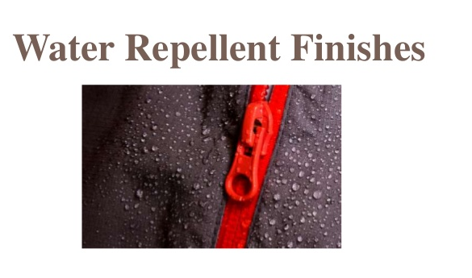

Slide 4
Online Class (Google Meet): Prepared by V.DEEPA Date:12.08.21, Class : III BSc CDF
Water repellent textiles are often high density woven materials made of very fine yarns or common materials with hydrophobic surface treatment.
Waterproofing is defined as the property of a material not to be penetrated by fluids. ... Such fabrics are completely waterproof even under very high pressure.
Water repellency of a fabric depends on several factors including nature of the fibers, yarn structure, fabric porosity, finish applied and water impact force.
Some fabrics such as those made from cotton easily wet out as compared to those made from hydrophobic fibers such as polypropylene.

Slide 5
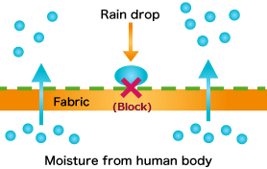
Online Class (Google Meet): Prepared by V.DEEPA Date:12.08.21, Class : III BSc CDF
In water repellent fabric, rain water drop can be block but at the same time perspiration can be out. Since the entire fabric is not coated, the fabric remains breathable and repels raindrops such as rainwater.
The principle is that it is coated with the repellent chemical which permits the passage of air and vapour between the interlacing in fabric.

Slide 6
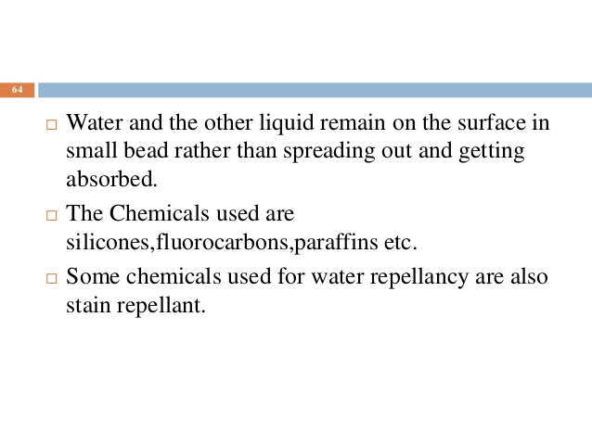

Slide 7
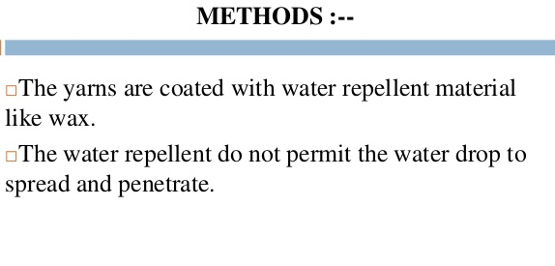

Slide 8
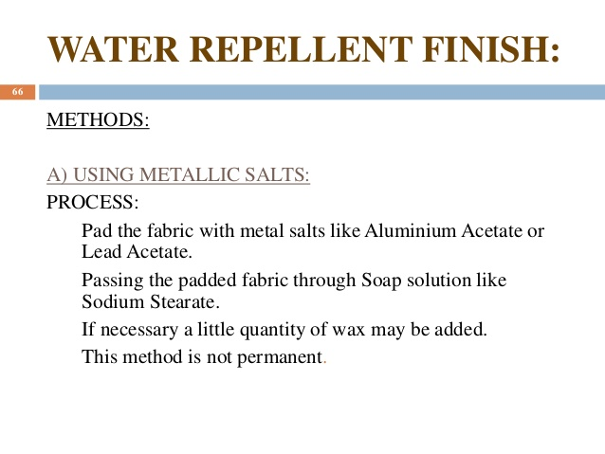

Slide 9
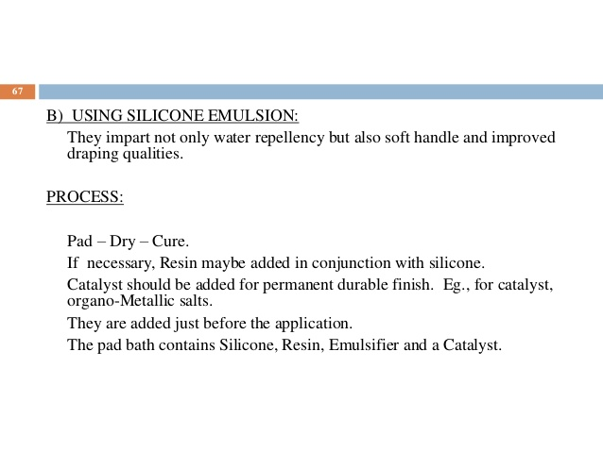

Slide 10
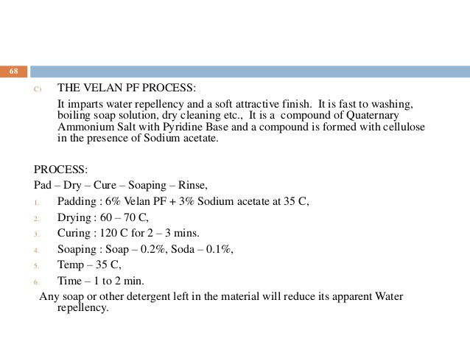
Online Class (Google Meet): Prepared by V.DEEPA Date:12.08.21, Class : III BSc CDF

Slide 11
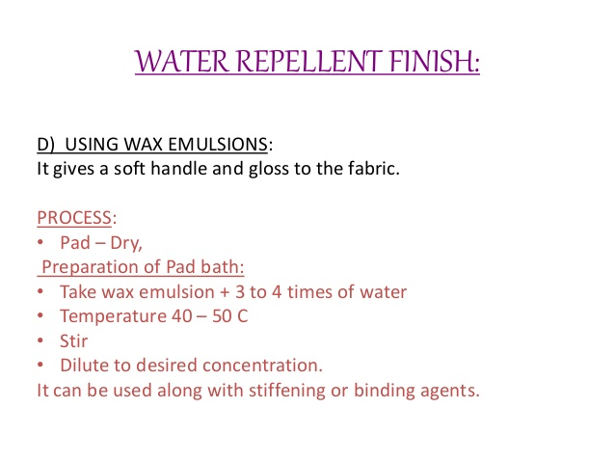

Slide 12
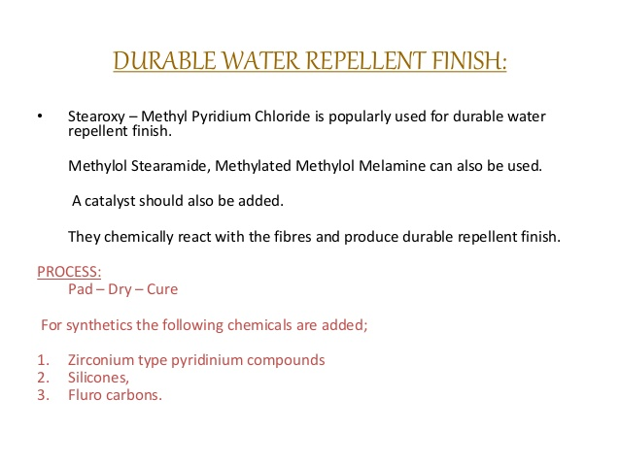

Slide 13
Water Repellency Test Methods:
Most used water repellency test method is is AATCC Test Method 22–2001: water repellency – spray test. This method involves spraying of water against the taut fabric surface under controlled conditions. Degree of wetting is rated from 0–5 scale, where 0 refers to complete wetting and 5 to no wetting.
Water proofing of the fabrics may be divided into two large classes:
Processes in which interstices of the cloth as well as the, surface of the fibers, are covered with a film or skin so that the goods & not-only water shedding but impermeable to air and moisture.
Processes whereby the fibers are made water repellent through coating with hydrophobic substance or by a chemical reaction, but the fabric remains porous to air.

Slide 14
APPLICATION :
Outdoor garments, Suit, Coat, Umbrella, Carpet, Surgical gown,
Automotive engine filter, Cardboard, etc...

Slide 15
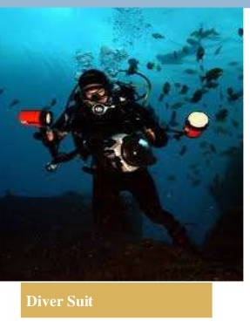
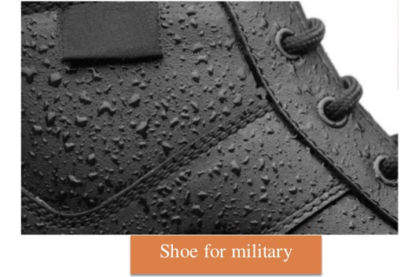

Slide 16
Online Class (Google Meet): Prepared by V.DEEPA Date:12.08.21, Class : III BSc CDF
MCQ
https://docs.google.com/forms/d/e/1FAIpQLSfqttpOQbI67RTfJ-d-xY9OI09t9ZidqIp9kS8EC1x63KP5Tg/viewform?usp=sf_link

