Slide 1

Hindusthan
College of Arts & Science
An Autonomous College- Affiliated to Bharathiar University
Approved by AICTE and Govt of Tamilnadu
Accredited by NAAC- An ISO Certified Institution
Class: III BSc COSTUME DESIGN &FASHION
SUBJECT:TEXTILE FINISHING TECHNOLOGY

Slide 2
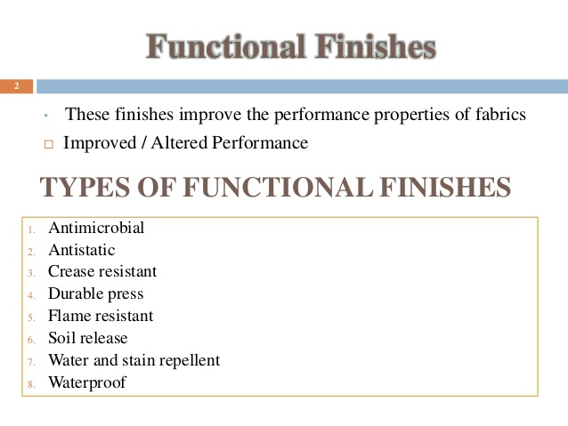

Slide 3


Slide 4
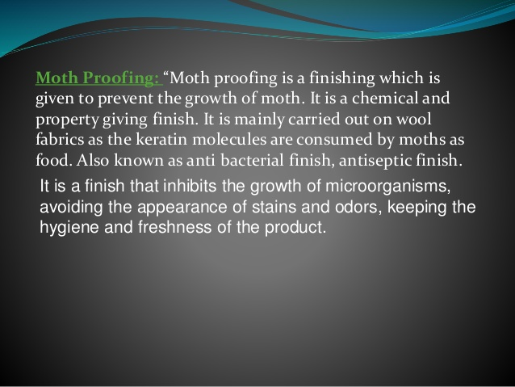

Slide 5
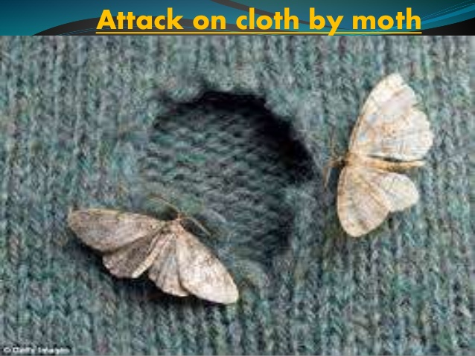

Slide 6
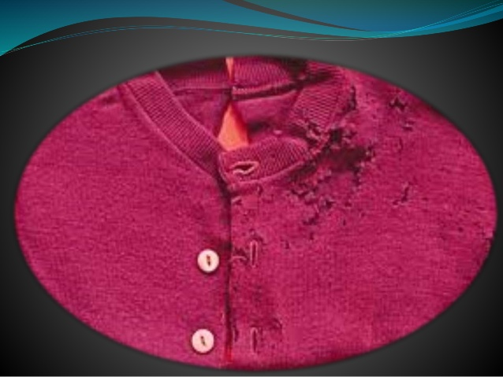

Slide 7
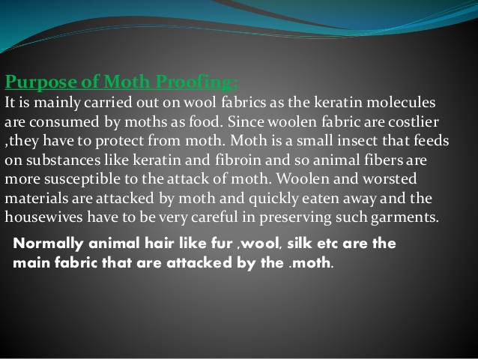

Slide 8
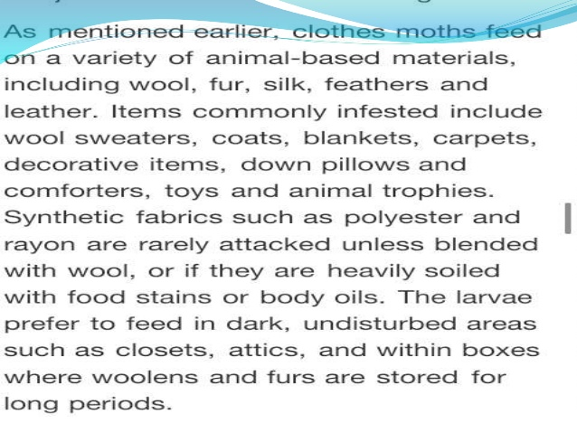

Slide 9
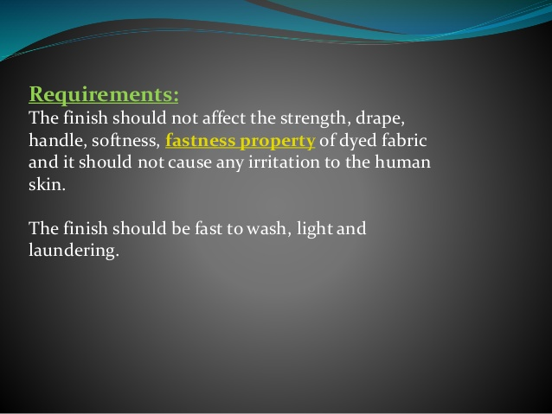

Slide 10
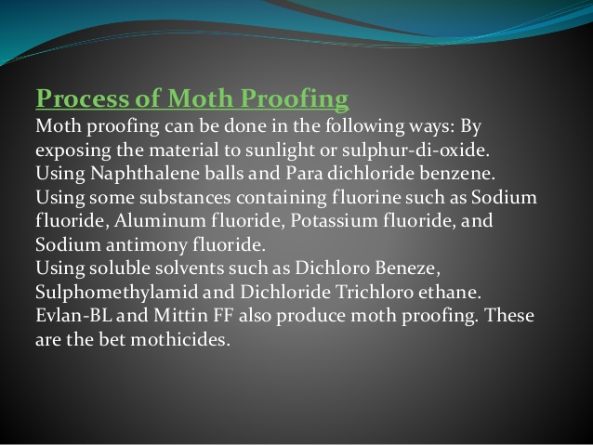

Slide 11
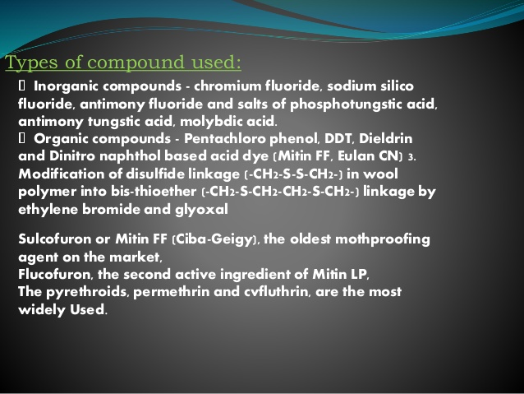

Slide 12
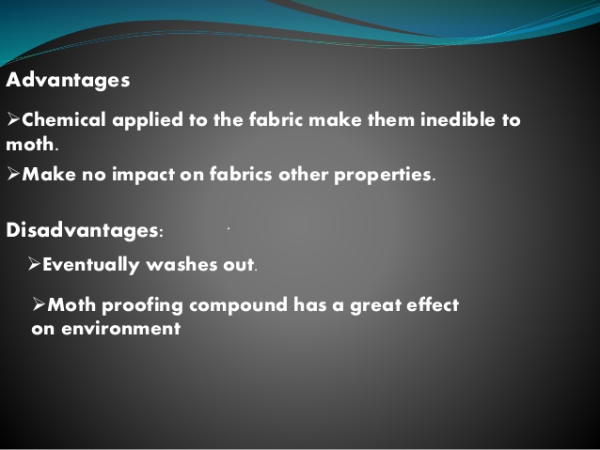

Slide 13
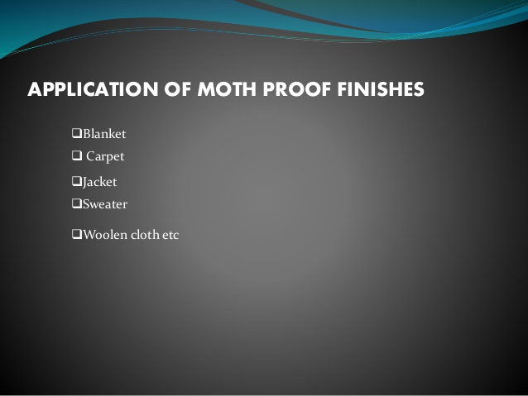

Slide 14
MCQ
https://docs.google.com/forms/d/e/1FAIpQLSdDZbw_YCewUQDgqiQSXt2NgXRj-npYXq2dVyl6A0tD79Tq3w/viewform?usp=sf_link

