Slide 1

Hindusthan
College of Arts & Science
An Autonomous College- Affiliated to Bharathiar University
Approved by AICTE and Govt of Tamilnadu
Accredited by NAAC- An ISO Certified Institution
Class: III BSc COSTUME DESIGN &FASHION
SUBJECT:TEXTILE FINISHING TECHNOLOGY

Slide 2
Online Class (Google Meet): Prepared by Deepa.V Date:15.09.2021, Class : III BSc CDF
SUPER CRITICAL FLUID DYEING
SFD is a waterless dyeing process and it is a one kind of fluid which is highly compressed gases which combine properties of gases and liquids in an intriguing manner. It is a substance which can be either liquid or gas, used in a state above the critical temperature and critical pressure where gases and liquids can coexist. It shows unique properties that are different from those of either gases or liquids under standard conditions.

Slide 3
Online Class (Google Meet): Prepared by Deepa.V Date:15.09.2021, Class : III BSc CDF
A supercritical fluid has both the gaseous property of being able to penetrate anything, and the liquid property of being able to dissolve materials into their components. In addition, close to the critical point, small changes in pressure or temperature result in large changes in density, allowing many properties of a supercritical fluid to be “fine-tuned”. Carbon dioxide and water are the most commonly used supercritical fluids.
The technology uses (reclaimed) CO2 as the dyeing medium in a closed-loop process. When heated and pressurised, CO2 becomes supercritical, a phase between a liquid and a gas. In this state CO2 has a very high solvent power, meaning the dye can dissolve easily and deeply into fibres, creating a vibrant colour.

Slide 4
Online Class (Google Meet): Prepared by Deepa.V Date:15.09.2021, Class : III BSc CDF
APPLICATION OF Sc CO2 IN TEXTILE
(a) Dyeing,
(b) Pre-treatments (scouring)
(c) Post-treatments (infusion of functional additives)
scCO₂ is ideally suited for dyeing polyester because many of the disperse dyes used for dyeing polyester are soluble in scCO₂. In addition, the disperse dyes are not soluble in water; hence they are mixed with large amounts of surfactants or modifiers so the dyes can be dispersed in water.
With scCO₂ as solvent, no surfactants or modifiers are needed hence press-cake or crude dyes can be dissolved directly in the scCO₂, thereby reducing dye costs and eliminating a large amount of additives that would conventionally end up in the waste water stream.

Slide 5
Online Class (Google Meet): Prepared by Deepa.V Date:15.09.2021, Class : III BSc CDF
General process for dyeing in scco₂ is a batch process
The key Process Steps are
• Load DRY textiles and dyes into pre-heated dyeing vessel
• Pump CO₂ to the desired pressure as a liquid
• Bring vessel to pressure with CO₂ at supercritical conditions
• scCO₂ is circulated in the system for about 30 minutes to complete the dyeing
• Dyed textile is leveled in the dyeing vessel
• CO₂ is depressurized. The CO₂ is recycled for re-use. More than 95% of the CO₂ is recycled.
• Dyed textile is removed DRY from the vessel.
• The system is now ready for the next cycle.

Slide 6
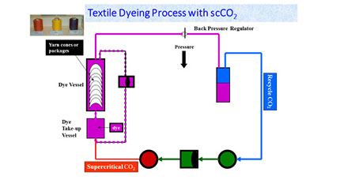
Online Class (Google Meet): Prepared by Deepa.V Date:15.09.2021, Class : III BSc CDF
Dyeing in scCO₂ is done in a temperature range of 80 to 120ºC; the pressure in dyeing vessel is in the range of 200 to 250 bar. The specific dyeing conditions are selected based on the desired color for the textile. The overall process time is 60 to 90 minutes, depending on the color and the size of the dyeing system.

Slide 7
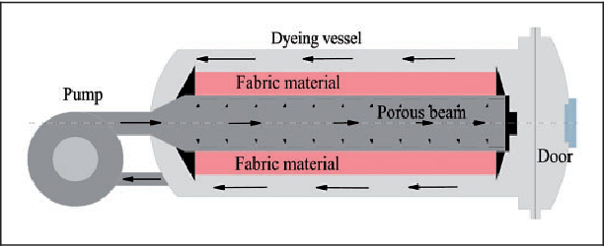
Online Class (Google Meet): Prepared by Deepa.V Date:15.09.2021, Class : III BSc CDF

Slide 8
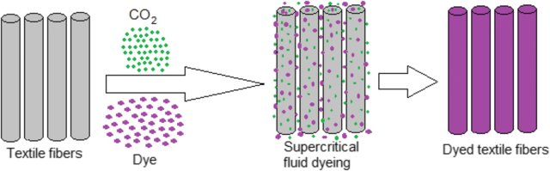
Online Class (Google Meet): Prepared by Deepa.V Date:15.09.2021, Class : III BSc CDF

Slide 9
Online Class (Google Meet): Prepared by Deepa.V Date:15.09.2021, Class : III BSc CDF
Why Supercritical Dyeing is better than conventional dyeing technique?
Waste water is not generated as water is not used while dyeing
No damage to the fibre
No need of dispersing or levelling agents
Short time as compared to conventional dyeing
Low dyes and chemical consumption
Carbon Dioxide can be recycled easily hence no air pollution
Drying is not required
Low energy consumption
No effluents
Environment friendly process

Slide 10
Online Class (Google Meet): Prepared by Deepa.V Date:15.09.2021, Class : III BSc CDF
ADVANTAGES:
The main advantage of this process is that solvent can be easily turned into gas by simply releasing the pressure leaving no solvent residues and requires no evaporation orseparation.
The low viscosity of supercritical fluids and the rather high diffusion properties of the dissolved molecules are especially promising aspects for dyeing processes.
A supercritical dyeing fluid should easily dissolve solid dyestuffs and should penetrate even the smallest pores without the need of vigorous convection procedures.

Slide 11
Online Class (Google Meet): Prepared by Deepa.V Date:15.09.2021, Class : III BSc CDF
DISADVANTAGES:
Initial investment is high.
High pressure and high temperature are required for dye solubility during the process.
It is a batch process. So processing of long length fabric (continuous) is not possible.
At present Supercritical fluid dyeing is only suitable for synthetic fibres

Slide 12
Online Class (Google Meet): Prepared by Deepa.V Date:15.09.2021, Class : III BSc CDF
MCQ
https://docs.google.com/forms/d/e/1FAIpQLSfrUTMSZYQZ24kIUHze8nPB906qM9TN9A5XpNcHsNosIvp6ew/viewform?usp=sf_link

Slide 13
Online Class (Google Meet): Prepared by Deepa.V Date:15.09.2021, Class : III BSc CDF

