Slide 1


Hindusthan
College of Arts & Science
An Autonomous College- Affiliated to Bharathiar University
Approved by AICTE and Govt of Tamilnadu
Accredited by NAAC- An ISO Certified Institution
Class: III BSc COSTUME DESIGN &FASHION
SUBJECT:TEXTILE FINISHING TECHNOLOGY

Slide 2
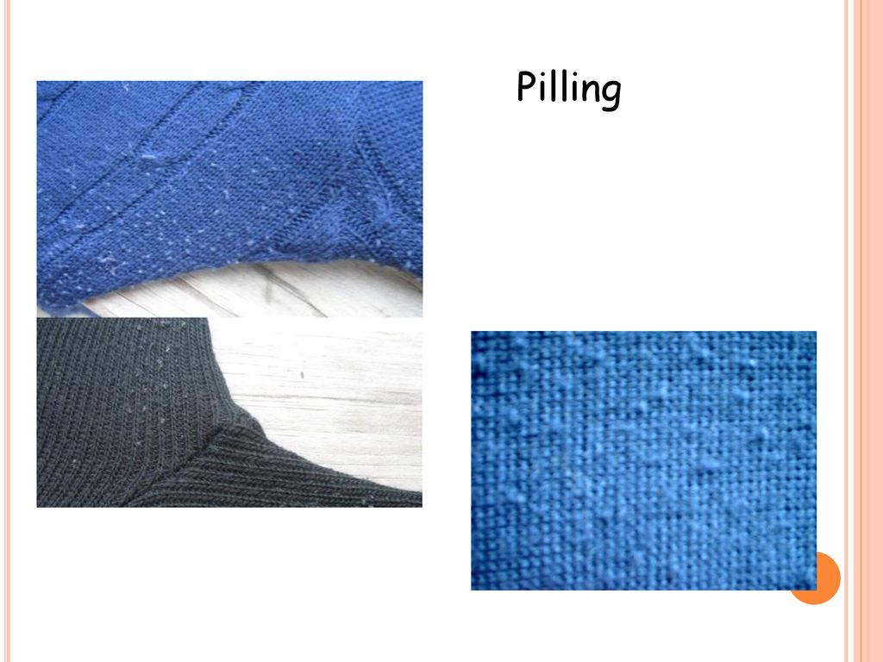
Online Class (Google Meet): Prepared by V.DEEPA Date:16.08.21, Class : III BSc CDF

Slide 3
Online Class (Google Meet): Prepared by V.DEEPA Date:16.08.21, Class : III BSc CDF
Pilling is formation of small knots of fibres on the surface of the fabric. These bundles of fibres are held to the fabric by entanglement with the surface fibres and spoil the appearance of the fabric or garment.
Reason : Fiber has very high tenacity (tensile strength) .
High tenacity fibres like nylon and polyester form pills. Blends of high and low tenacity fibres such as terywool also forms pills.

Slide 4
Online Class (Google Meet): Prepared by V.DEEPA Date:16.08.21, Class : III BSc CDF
Low tenacity fibers like cotton, wool, silk, and viscose rayon there is no pilling problem.
If they are formed , they are rubbed off or washed off during wear the problem of pilling is mainly confined to polyester.
FACTORS INFLUENCING PILLING:
Fiber characteristics
Yarn construction
Fabric construction

Slide 5
Online Class (Google Meet): Prepared by V.DEEPA Date:16.08.21, Class : III BSc CDF
FIBRE CONSTRUCTION:
1. Fiber Nature: Natural fibers are less susceptible to pilling than synthetic.
2. Fiber Fineness: Finer fibers are more susceptible to pilling as there is more propensity to bending. For example Angora is more susceptible to pilling than normal wool.
3. Longer the staple length, less is the tendency to form pills.
4. Higher the denier lesser the pilling.
5. Fiber Length: Shorter fibers are more susceptible to pilling

Slide 6
Online Class (Google Meet): Prepared by V.DEEPA Date:16.08.21, Class : III BSc CDF
Yarn Finishing: Un singed yarns have more tendency to pill.
Finer the yarn count lesser is the pilling.
Higher twist in the yarn is lesser in pilling.
Thick places in the yarn contain less twist so that the loosely held fibres join to form pills during wear.
Protruding fibres on the hairy yarn help pilling. Plied yarns show less pilling than single yarn.

Slide 7
Online Class (Google Meet): Prepared by V.DEEPA Date:16.08.21, Class : III BSc CDF
Fabric Parameters
Closer fabric structures lead to less pilling.
If the fabric is subjected to long processes in finishing and processing there is more friction and hence more pilling is formed.
Use of anti-pilling finishes can reduce the tendency of pilling.

Slide 8
Online Class (Google Meet): Prepared by V.DEEPA Date:16.08.21, Class : III BSc CDF
Apart from technological factors, a few of the important factors for pilling are:
1. The person wearing the garment, if that person is particularly hard on garments, pilling tendency is more.
2. There are some susceptible parts of garments such as collars, cuffs, pocket edges which are more susceptible to pill, as there is more rubbing/chafing of the parts.
3. Garments which are frequently washed are more susceptible to pilling.

Slide 9
Online Class (Google Meet): Prepared by V.DEEPA Date:17.08.21, Class : III BSc CDF
ANTI PILLING TREATMENT:
1.Construction of the fabric
2.Finishing treatments
i. Physical process
ii. Chemical process
iii. Special treatments
3.Selection of anti-pilling fibres

Slide 10
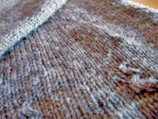
Online Class (Google Meet): Prepared by V.DEEPA Date:17.08.21, Class : III BSc CDF
Construction of the fabric
The construction of the fabric is also important in determining its susceptibility to pilling. A very tight, compact construction, such as denim, usually pills very little. However, a loosely knitted or woven fabric will show more pilling with both wear and cleaning. Pilling is often more noticeable on knitted fabrics, such as sweaters, than on woven. Lint often becomes tangled in the little balls of fibre, which makes the pilling appear more obvious.

Slide 11
Online Class (Google Meet): Prepared by V.DEEPA Date:17.08.21, Class : III BSc CDF
Suggestions for minimizing pilling:
Turn susceptible garment inside out before laundering.
Load the washer loosely to provide free circulation and minimize abrasion on the garment.
Use a shorter wash time for permanent press, knits, and delicates unless they are heavily soiled.
Wash permanent press, knits, and delicates in separate load from articles that have a tendency to lint.
Use a fabric softener to reduce static and prevent lint from clinging to the fabrics.

Slide 12
Online Class (Google Meet): Prepared by V.DEEPA Date:17.08.21, Class : III BSc CDF
2) Finishing treatments
There are various methods of finishing process, which are used for controlling/reducing the pills formation.
i) Physical processes for reducing pilling
a) Shearing or Cropping
Cropping and shearing reduce pilling by reducing the length of the projecting fibres. It gives a much superior handle to singeing.
b) Singeing
Singeing with shearing/cropping and optimum heat setting would reduce pilling. The parameters during singeing will have to be optimised with respect to speed, quality of flame and number of passages to obtain the fabric with the desired level of pilling resistance.

Slide 13
Online Class (Google Meet): Prepared by V.DEEPA Date:17.08.21, Class : III BSc CDF
c) Brushing
In the case of tighter-woven fabric made from highly twisted yarn, loose fibres can be brought to the surface of fabric by means of brushing, where they can be removed by a close shearing. Such a procedure is not possible on loosely spun yarns with a fluffy surface.
d) Anti-pilling finish
Alleviates pilling, an unpleasant phenomenon associated with spun yarn fabrics, especially when they contain synthetics. Synthetic fibres are more readily brought to the surface of a fabric due to their smooth surface and circular cross-section, and due to their higher tensile strength and abrasion resistance. Knitting is susceptible to pilling due to the open weave and bulky yarn.

Slide 14
Online Class (Google Meet): Prepared by V.DEEPA Date:18.08.21, Class : III BSc CDF
e) Heat Setting
Heat setting of synthetic fabrics eliminates the internal tensions within the fibre, generated during manufacture and the new state can be fixed by rapid cooling. This heat setting fixes the fabrics in the relaxed state and thus avoids subsequent shrinkage or creasing of fabric.
The application of heat in heat setting can be done by hot air, on a pin stenter at 220°C for 20 - 30 seconds for polyester goods and at a lower temperature range of 190 - 225°C for 15 - 20 seconds for polyamides. Acrylics may be heat set partially at 170 - 190°C for 15 - 60 seconds to reduce formation of running creases, but higher temperature should be avoided to prevent yellowing.

Slide 15
Online Class (Google Meet): Prepared by V.DEEPA Date:18.08.21, Class : III BSc CDF
f) Steam setting
Steam setting can be done by saturated or super heated steam. Super heated steam can be used in stenters and setting time is 25% shorter than for hot air on account of quicker heating up rate.
Acrylic fibres have to be protested as some may undergo excessive shrinkage or loss of handle. Before the material is heat set, it should be thoroughly washed to remove lubricants, sizing agents and impurities as these are likely to be burned in drying heat setting making their removal difficult. Steaming at temperatures above 100°C (generally 120°C or 130°C) also reduces the pilling .

Slide 16
Online Class (Google Meet): Prepared by V.DEEPA Date:18.08.21, Class : III BSc CDF
ii) Chemical finishes for reducing pilling
The different chemical finishing approaches have been made to prevent pill from accumulating on fabric surface which include the following:
a) Application of polymers by padding and coating techniques.
b) Application of enzymes (bio-finish) to 100% cotton textiles to cause removal of loose fibres in the yarn to reduce pilling tendency.
c) Anti-static finish

Slide 17
Online Class (Google Meet): Prepared by V.DEEPA Date:18.08.21, Class : III BSc CDF
Application of polymers by padding and coating techniques
The polymeric formulations bring about the binding of the loose fibres into the fabric. The products normally used in this type of finish are friction-reducing lubricants to minimize damage due to abrasion.
The acrylic co-polymers, which can be modified to suit the requirements are normally used. Examples of few are:
Softeners, which decrease fibre-to fibre friction by internal lubrication, such as non-ionic organo-modified silicone micro emulsions and amino functional polysiloxanes, result in a decrease in fabric pilling performance.

Slide 18
Online Class (Google Meet): Prepared by V.DEEPA Date:18.08.21, Class : III BSc CDF
In the second approach, biopolishing with cellulase enzyme is carried on 100% cellulosic or cellulose rich blend fabrics to eliminate loose fibres, which results in clean and smooth surface with improved pill rating.
The bio-polishing process targets the removal of the small fibre ends protruding from the yarn surface and thereby reduces the hairiness or fuzz of the fabrics.
The hydrolysis action of the enzyme weakens the protruding fibres to the extent that a small physical abrasion force is sufficient to break and remove them.

Slide 19
Online Class (Google Meet): Prepared by V.DEEPA Date:18.08.21, Class : III BSc CDF
b) Application of enzymes (bio finish) to 100% cotton textiles to cause removal of loose fibres in the yarn to reduce pilling tendency
Biopolishing can be accomplished at any time during wet processing but is most convenient performed after bleaching. It can be done in both continuous or batch processes. However, continuous processes require some incubation time for enzymatic degradation to take place. Removing the fuzz makes the colour brighter, the fabric texture more obvious, and reduces pilling.

Slide 20
Online Class (Google Meet): Prepared by V.DEEPA Date:18.08.21, Class : III BSc CDF
c) Anti-static finish
Anti-static finish prevents dust from clinging to the fabric. Anti-static effective chemicals are require heat treatment for fixing on polyester fabrics. Thermasol anti-static agents have a good soil release action, which is as permanent as the anti-static effect. Anti-static finishes are curable at moderate temperatures.

Slide 21
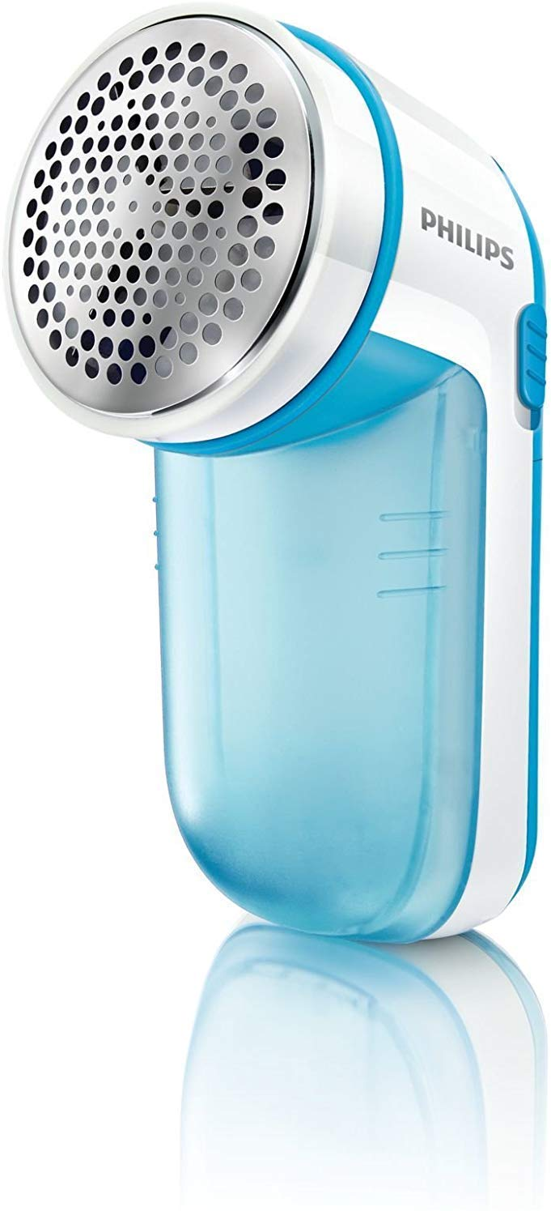
Online Class (Google Meet): Prepared by V.DEEPA Date:18.08.21, Class : III BSc CDF
iii) Special treatments
The special machine treatments are also controlling the pilling in fibres and fabrics.
a) Electric piller/Fabric shaver
Fabric shavers are easy for removing pills on a flat knit, but they should not be used on knits with naps, textures surfaces.

Slide 22
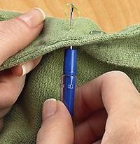
Online Class (Google Meet): Prepared by V.DEEPA Date:18.08.21, Class : III BSc CDF
b) Knit picker
For any snags or loose ends of yarn, can be removed with a "knit picker". These are hook-like tools with an eye that draws the yarn from the outside of the garment to the inside.

Slide 23
Online Class (Google Meet): Prepared by V.DEEPA Date:18.08.21, Class : III BSc CDF
c) Sanforising
Sanforising resulted in a decrease in pilling rating. after sanforising friction between the rubber blanket and the steel drum, which forces the fabric yarns to come closer, possibly causes some weakening of the fabric surface .
d) UV treatment
A new method, Siroflash anti-pilling treatment for knitted fabrics is a process involving exposure of the fabric or garment surface to short wavelength ultraviolet radiation (UVC), followed by a mild wet oxidation treatment using, for example, hydrogen peroxide .

Slide 24
Online Class (Google Meet): Prepared by V.DEEPA Date:18.08.21, Class : III BSc CDF
UVC exposure weakens the bulk fibres responsible for fabric strength. Because the surface fibres are much weaker after treatment, no anchor fibres are available to secure pills to the fabric surface. The treatment is a highly effective, chlorine-free method of preventing pilling in wool knitwear.
3) Anti-pilling fibres
The low-pilling effect in synthetic fibres is obtained by chemical modification or by using low molecular weight spinning raw materials. The use of longer staple fibres in worsted yarns compared to shorter fibres used in cotton spun yarns may also reduce pilling. The finer the fibre the less pilling occurs, as flexing elasticity is reduced. Thus pilling is avoided.

Slide 25
Online Class (Google Meet): Prepared by V.DEEPA Date:18.08.21, Class : III BSc CDF
Birla Acrylic® has introduced an innovative fibre which reduces pill formation over repeated usage.
Birla Acrylic® Anti-Pill fibres reduce pilling in fabrics and subsequently slow down apparel aging.
Birla Acrylic® delivers a high pilling grade of 4 - 4.5 (on a scale of 5) following ICI Pill Box Test. The Anti-Pill fibre has been specifically engineered to have sustainable anti-pilling performance throughout the lifetime of the apparel.
Trevira 350 is a low-pill polyester fibre for the weaving and knitting sectors.

Slide 26
Online Class (Google Meet): Prepared by V.DEEPA Date:18.08.21, Class : III BSc CDF
CHEMICAL TREATMENT:
The fabric is treated with 2gpl of Caustic soda solutions at 60c for 30 minutes washed, dried and heat set.
In another method the fabric is treated with 3-5% Ammonium solutions at 130c for a few minutes following by washing and drying.
The mechanism involved in the above two methods is reduce the strength of the fibre resulting in Lower pilling.

Slide 27
Online Class (Google Meet): Prepared by V.DEEPA Date:17.08.21, Class : III BSc CDF
Another simple method of reducing the pilling tendency is to apply a solution of adhesive or resin so as to make the fibre cling more strongly to each other in the yarn and fabric.
For this a 2.6% aqueous emulsion of Poly vinyl Chloride is applied by Pad-Dry-Cure method.

Slide 28
Online Class (Google Meet): Prepared by V.DEEPA Date:18.08.21, Class : III BSc CDF
MCQ
https://docs.google.com/forms/d/e/1FAIpQLSfxDkzefAzMctLWmNcYrxrKUb3K9pfWFbacnZ3yJdItQJQ8Mg/viewform?usp=sf_link

Slide 29
Online Class (Google Meet): Prepared by V.DEEPA Date:16.08.21, Class : III BSc CDF

