Slide 1

SUBJECT : TEXTILE WET PROCESSING
CLASS : II BSc –CDF
UNIT - 4

Slide 2

Onlineclass(Googlemeet) Prepared by : V.Deepa Class: II.B.Sc CDF 23/10/2021
OZONE TECHNOLOGY IN DENIM WASH:
Over the last eight years, Ozone has made a prominent place for itself in the garment processing industry all over the world. Widely used as a bleaching agent, Ozone remains a powerful, secret tool within the denim industries that gave denim garments an unique and distinctive look and feel from other traditional processing.
Depending on the desired effect, denim garments are treated with different substances.
A lot of dry and wet processing techniques are used for desired effects Wet processes in denim washing are not environment friendly.
High water and energy consumption, large amount of wastewater, and solid waste like pumice stones are generally environmental problem in denim washing.

Slide 3
Onlineclass(Googlemeet) Prepared by : V.Deepa Class: II.B.Sc CDF 23/10/2021
Sodium hypochlorite is a very common bleaching agent in denim washing but the garments smell unless they are subjected to an ‘anti-chlor’ process, usually using sodium bisulphite, and rinsed repeatedly.
The effluent from the process contains chlorinated species that can be difficult to remediate.
Ozone (O3) is a very strong oxidising agent that can be used to provide all over bleaching of denim garments in a closed, batchwise operation.

Slide 4
Onlineclass(Googlemeet) Prepared by : V.Deepa Class: II.B.Sc CDF 23/10/2021
Ozone is generated by applying, typically electricity or UV radiation to oxygen (O2) and this is fed into the washing machine for processing.
ozone is a gas so this significantly reduces the water requirement.
After the ozone bleaching process has been completed the garments require one or two standard washes to remove residues of ozone and the residues of the bleached indigo dye.
Denim fabric has a blue warp and white weft and denim garments typically have white pocket bags and are sewn with white or yellow threads.

Slide 5
Onlineclass(Googlemeet) Prepared by : V.Deepa Class: II.B.Sc CDF 23/10/2021
Typical washing process, can cause back-staining of loose blue dye onto white yarns in the fabric.
Ozone bleaching is being very good in terms of low levels of back-staining.
Ozone is highly reactive and can cause severe damage to machines, seals, plastics, pipes etc. Therefore installations must have appropriate materials with appropriate automated safety devices.
PROCESS:
In the Ozone processing system, first the Ozone is generated by isolating pure Oxygen from atmospheric air through sophisticated electrodes, and pump that air to next equipment fitted with another set of electrodes that convert oxygen into ozone and pumps it for garment processing.

Slide 6
Onlineclass(Googlemeet) Prepared by : V.Deepa Class: II.B.Sc CDF 23/10/2021
To maintain the purity of the ozone generated, the temperature is kept below 14C during the conversion for which chilled water is used.
Special chillers are used for this purpose along with ozone generators.
Tumbler is the third part of this process, where ozone gas is introduced and removed after processing.
The process time is 15 to 20 min. During this time; tumbling action slowly turns over the garments for even exposure to the gas circulating in the entire tumbler.

Slide 7
Onlineclass(Googlemeet) Prepared by : V.Deepa Class: II.B.Sc CDF 23/10/2021
with the help of the exhaust pipe the gas in the tumbler is flushed into the atmosphere or to effluent treatment system
ADVANTAGES OF OZONE BLEACHING
Fewer chemicals used in bleaching
Ozone bleaching process is faster than sodium hypochlorite bleaching so processes can be shorter
Less water used
Less energy required to heat water
Lower volume of effluent / lower effluent loading
overall processes are shorter and machines are more productive
Reduced back-staining

Slide 8
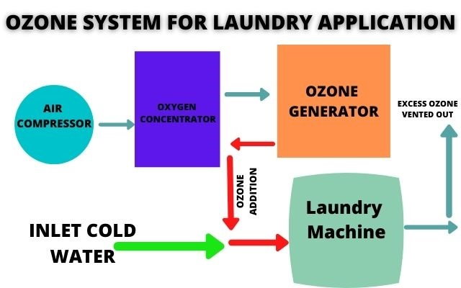
Onlineclass(Googlemeet) Prepared by : V.Deepa Class: II.B.Sc CDF 23/10/2021

Slide 9
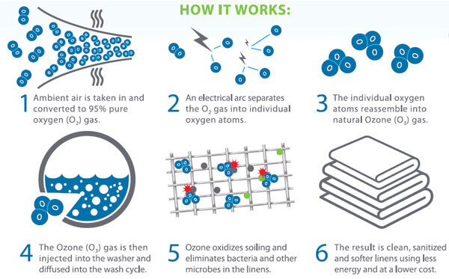
Onlineclass(Googlemeet) Prepared by : V.Deepa Class: II.B.Sc CDF 23/10/2021

Slide 10
Onlineclass(Googlemeet) Prepared by : V.Deepa Class: II.B.Sc CDF 23/10/2021
MCQ
https://docs.google.com/forms/d/e/1FAIpQLSeC6iL5uXd7KXRpnjvYR2VrVlkxzJB88G9yADmsa1rHSCoOag/viewform?usp=sf_link

Slide 11
Onlineclass(Googlemeet) Prepared by : V.Deepa Class: II.B.Sc CDF 23/10/2021
AN SIMPLE AV FOR OZONE TREATMENT IN DENIM WASHING
https://youtu.be/DQfPXRsW-3U

