Slide 1

SUBJECT : TEXTILE FINISHING TECHNOLOGY
CLASS : III BSc –CDF
UNIT - 4

Slide 2

Onlineclass(Googlemeet) Prepared by : V.Deepa Class: II.B.Sc CDF 27/10/2021
ULTRA SONIC DYEING
Ultrasound assisted textile dyeing is an alternative method of conventional dyeing of textile materials, providing energy saving by reducing the dyeing times & temperatures and consumptions of auxiliaries with increased dyeing efficiency.
ULTRASONICS
Sound wave is a vibration that is transmitted through a medium, such as air, water, and metals. Ultrasonic wave is defined as “inaudible sound with high frequency for human” the frequency of which generally exceeds 20 kHz.

Slide 3
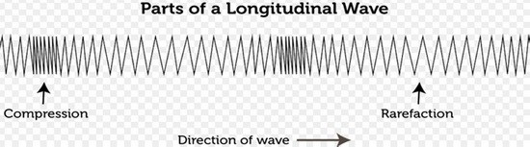
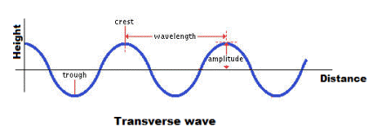
Onlineclass(Googlemeet) Prepared by : V.Deepa Class: II.B.Sc CDF 27/10/2021
Let see how ultrasonic waves works:

Slide 4
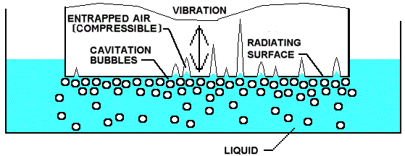
Onlineclass(Googlemeet) Prepared by : V.Deepa Class: II.B.Sc CDF 27/10/2021
Formation of cavitations:
Ultrasound energy is sound waves with frequencies above 20,000 oscillations per second. In liquid, these high-frequency waves cause the formation of microscopic bubbles, or cavitations. They also cause insignificant heating of the liquid.

Slide 5
Onlineclass(Googlemeet) Prepared by : V.Deepa Class: II.B.Sc CDF 27/10/2021
Compression or rarefaction:
There is a compression during each cycle of wave. When ultrasonic waves are absorbed in liquid system, the phenomenon of cavitations take place, which is the alternative wave formation, oscillation or collapse of tiny bubbles or cavities. When the bubbles collapse, they generate tiny but powerful shock waves.

Slide 6
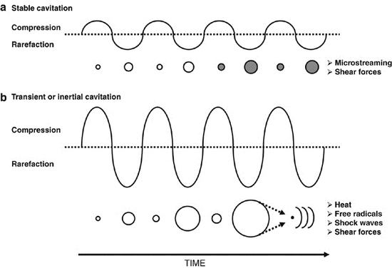
Onlineclass(Googlemeet) Prepared by : V.Deepa Class: II.B.Sc CDF 27/10/2021

Slide 7
Onlineclass(Googlemeet) Prepared by : V.Deepa Class: II.B.Sc CDF 27/10/2021
Streaming:
Pushes water along with the bubbles producing a flow of water called streaming away from the sound source. The two phenomena attributed to ultrasound are the rapid movement of liquids caused by variation of sonic pressure which subjects the solvent to compression and micro streaming. Simultaneous formation and collapsing of tiny air bubbles result in a large increase in pressure and temperature at microscopic level.

Slide 8
Onlineclass(Googlemeet) Prepared by : V.Deepa Class: II.B.Sc CDF 27/10/2021
Application on textile dyeing process:
The use of ultrasonic waves in the dyeing process can be explained as:
when ultrasonic waves are absorbed in the liquid system the cavitations/bubbles created. Cavitations can release entrapped gases from liquid or materials like textiles, dye bath etc.
In a dye bath, vibration of waves makes compressions. They create very small vapor bubbles of 500nm in size, which can collapse and cause shock waves throughout the bath .
If the bubbles collapse in textile materials, it results the formation of a high velocity micro jet with the velocities as highly directed towards the solid surface. pushes water along with the bubbles producing a flow of water called streaming away from the sound source

Slide 9
Onlineclass(Googlemeet) Prepared by : V.Deepa Class: II.B.Sc CDF 27/10/2021
Potential Benefits:
Saving energy by dyeing at lower temperatures.
Reduced processing times.
Reduces the use of auxiliary chemicals.
Enhancement of color shade.
Reduces processing costs.
Lesser load to the effluent.
This process is unsophisticated and harmonized with nature.

Slide 10
Onlineclass(Googlemeet) Prepared by : V.Deepa Class: II.B.Sc CDF 27/10/2021

Slide 11
Onlineclass(Googlemeet) Prepared by : V.Deepa Class: II.B.Sc CDF 27/10/2021

