Slide 1

Hindusthan
College of Arts & Science
An Autonomous College- Affiliated to Bharathiar University
Approved by AICTE and Govt of Tamilnadu
Accredited by NAAC- An ISO Certified Institution
Class: III BSc COSTUME DESIGN &FASHION
SUBJECT:TEXTILE FINISHING TECHNOLOGY

Slide 2
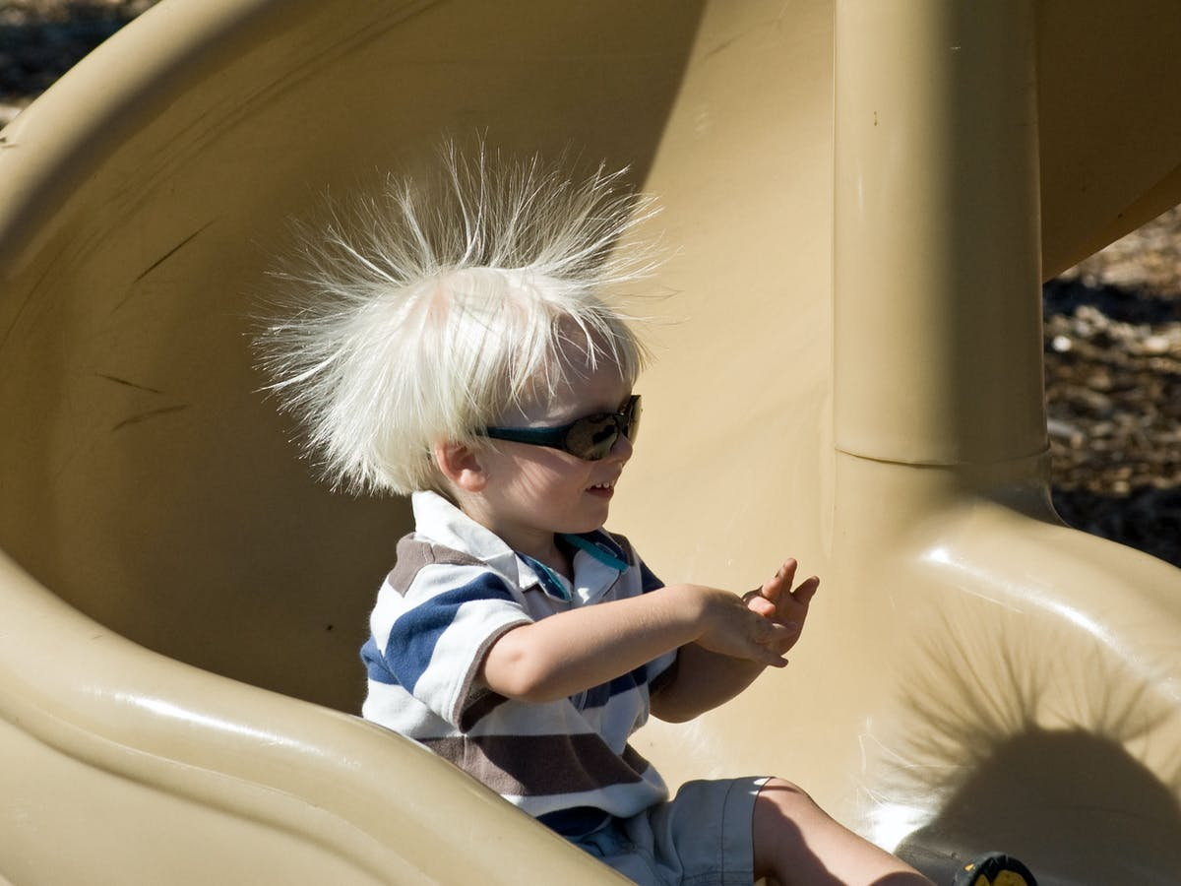
Online Class (Google Meet): Prepared by V.DEEPA Date:27.08.21, Class : III BSc CDF
ANTI STATIC FINISH
Due to friction between two surfaces, a charge is created there is called Static Electricity.
These charges can not move from the place to another place. But between the two surfaces the charges can exchanged with one another. Static Electricity is also known as Frictional Electricity.

Slide 3
Online Class (Google Meet): Prepared by V.DEEPA Date:27.08.21, Class : III BSc CDF
The nature and amount of static charge formation will be different based on different fibres. Usually, in case of manmade fibres this charge generation will be higher if it is compared to natural fibres.
Due to this shocks are experienced while working on the stenter, zero – zero machines etc., and the fabrics get entangled and soil attraction takes place which is also a problem. There fore the synthetic fabrics are given a finish to prevent the static charge generation . This is known as Anti static finish.

Slide 4
Online Class (Google Meet): Prepared by V.DEEPA Date:27.08.21, Class : III BSc CDF
Effects of Static Electricity formation in Textile Industry:
Similar charges repel each other:
1.Charged filaments in a beam will be blown out away from one another.
2. Cloth will not be folded down properly
3. Difficulties in fabric spreading of cutting section at garments industry
Unlike charges attract each other:
Difficulties in parachute opening
Different parts of a garment may be sticked together
Difficulties in materials handling

Slide 5
Online Class (Google Meet): Prepared by V.DEEPA Date:27.08.21, Class : III BSc CDF
Attraction between a charged textile material and another charged particle:
Dusts, dirts etc may be attached with the textile material and make it dirty.
During processing, fibres can be lapped around drafting rollers
Fibres may be sticked with different parts of a machine.
Methods of static electricity minimization:
By controlling relative humidity% in spinning and weaving industry it is possible to reduce static charge formation.
By applying conductive liquid such as oil, emulsion etc on textile materials, static charge generation may be reduced.
By blending conductive material with non-conductive material static charge formation can be reduced.
By using anti-static finishes to the textile materials it is possible to reduce the charge formation

Slide 6
Online Class (Google Meet): Prepared by V.DEEPA Date:27.08.21, Class : III BSc CDF
By reducing the charge.
By increasing the surface conduction power,
By making the fiber hydrophilic
Most of the anti static finishes are based on the mechanism i.e. by reducing the charge and increasing the surface conduction.
Silicone emulsions, PE emulsions, PE Glycerol, Poly Quaternary Salts, Acrylic Polymers and Ammonium used for this purpose.
In fact the Silicone emulsion when used, produces anti static property by reducing the friction between the fibres with added advantages of soil release property,softness and suppleness etc.
Today Antistat PP' is used on polyester fabrics in 5- 10 gpl concentration by Pad - Dry Cure method.

Slide 7
Online Class (Google Meet): Prepared by V.DEEPA Date:27.08.21, Class : III BSc CDF
There are two methods of application of anti static agents
1) By incorporating non-durable anti static agents into polymer during manufacture of synthetic fibres.
2) By applying either non-durable or durable anti static agents. on the filament or yarn or fabrics.
These are applied either by Exhaust method or by Pad - Dry Cure

Slide 8
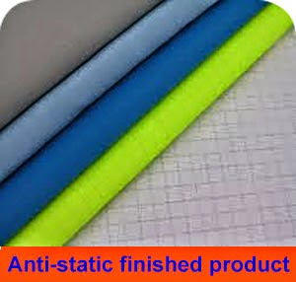
Online Class (Google Meet): Prepared by V.DEEPA Date:27.08.21, Class : III BSc CDF
Method Some of the commercial antistatic agents for synthetic fibres are Cirrasol PT (ICI), Ceramine R.ANS (Sar.doz).Antistatic Oil, Antista D,M (Abura chemical products) Antistatic Oil, Antista D
Application
Although antistatic finishes applied after dyeing or printing is more common with hydrophobic fibres, fabrics made from cotton, rayon and wool may also be antistatic treated depending on the intended use. The textile products that are treated with antistatic finishes includes –

Slide 9
Online Class (Google Meet): Prepared by V.DEEPA Date:27.08.21, Class : III BSc CDF
a) Carpets for computer room.
b) Upholstery fabrics and airbags for automobiles.
c) Conveyor belts.
d) Filtration fabrics.
e) Airmail bags, parachutes.
f) Fabrics for hospital operating rooms and
g) Protective clothing for work with flammable gases, liquids and powdered solids.

Slide 10
Online Class (Google Meet): Prepared by V.DEEPA Date:27.08.21, Class : III BSc CDF
MCQ
https://docs.google.com/forms/d/e/1FAIpQLSe9lJY1UDAKhDrcP_ju9wwkpreSUwEPiNifNQUcmnvetPH7TA/viewform?usp=sf_link

