Slide 1

Hindusthan
College of Arts & Science
An Autonomous College - Affiliated to Bharathiar University
Approved by AICTE and Govt. of Tamilnadu
Accredited by NAAC - An ISO Certified Institution
II M.Sc. CDF (III Sem)
Textile Testing
Unit 2-Fibre Testing
Ashwini.S.M
Assistant Professor
Dept. of CDF
00/00/2021

Slide 2
Unit 2
Fibre Testing
Cotton Fibre length - Baer Sorter
Fineness - Air flow principle instrument, Sheffield micronaire
Maturity - Caustic soda swelling
Strength - Pressley bundle strength tester, stelometer
Determination of trash and lint in cotton – Shirley trash analyzer

Slide 3
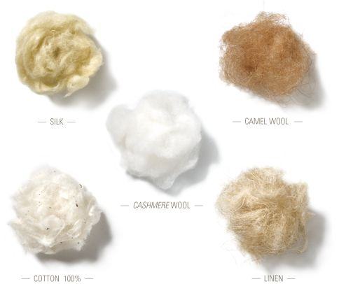
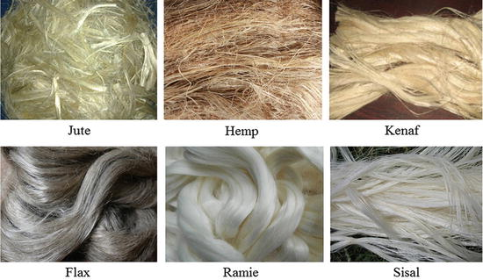
What are fibers?
A fiber is a fine threadlike piece, with a length at least 100 times greater than the width. Fibres are raw materials (natural or manufactured) used to make yarns and fabrics.

Slide 4
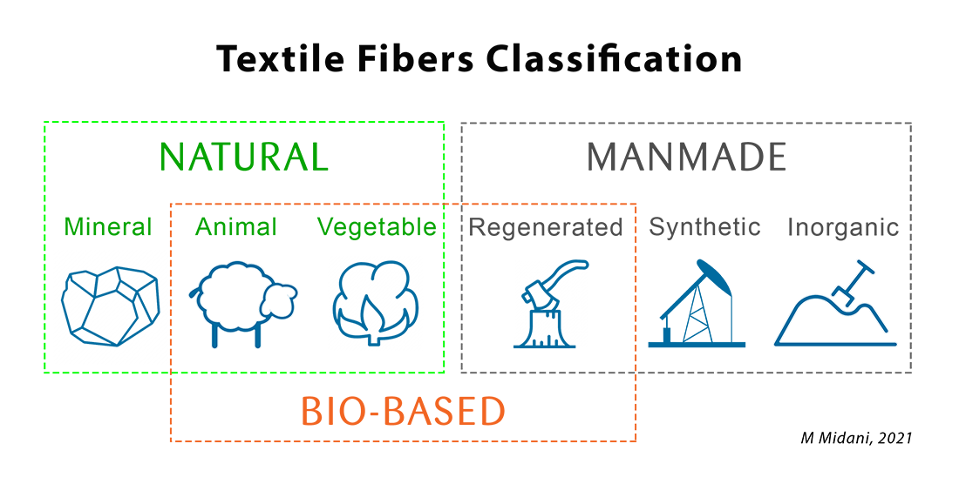

Slide 5
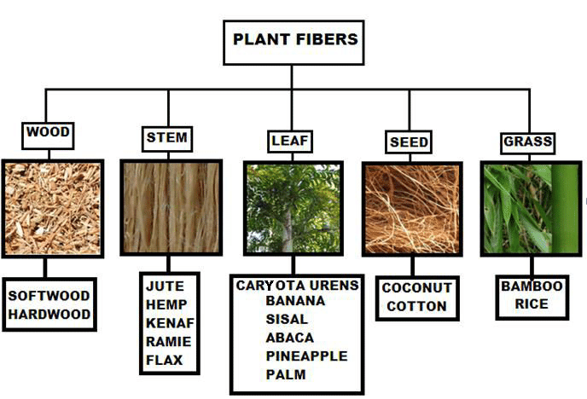

Slide 6
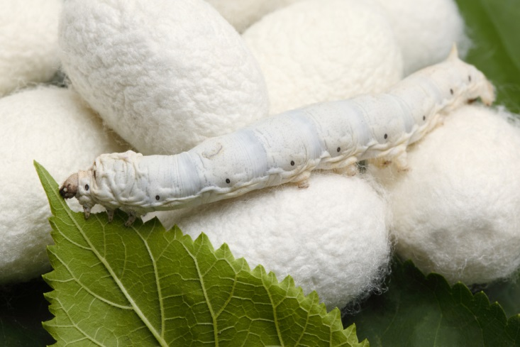
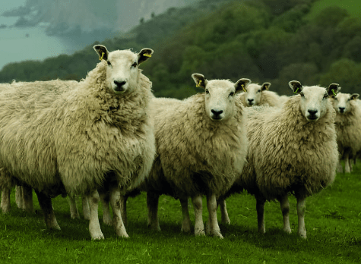
Animal Fibres
Silk
Wool

Slide 7
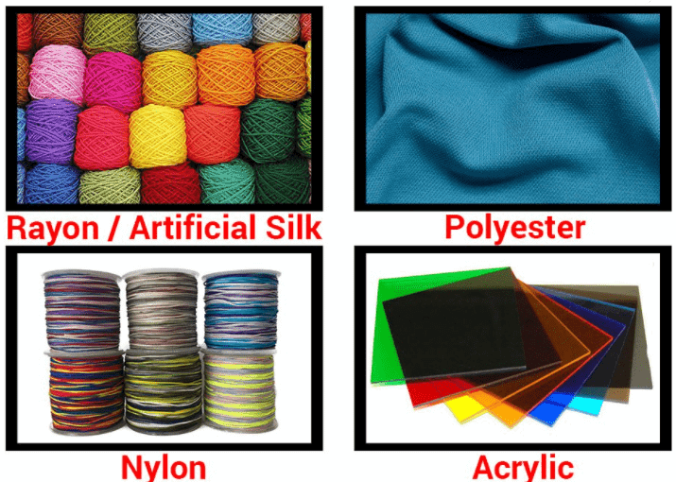

Slide 8
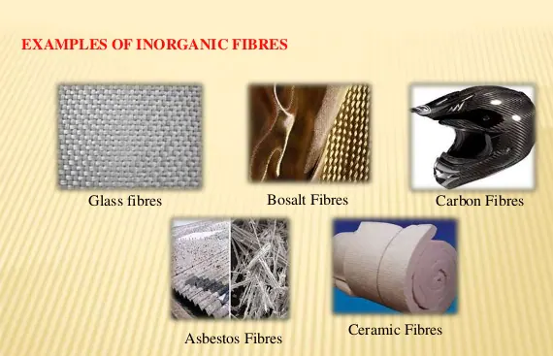

Slide 9
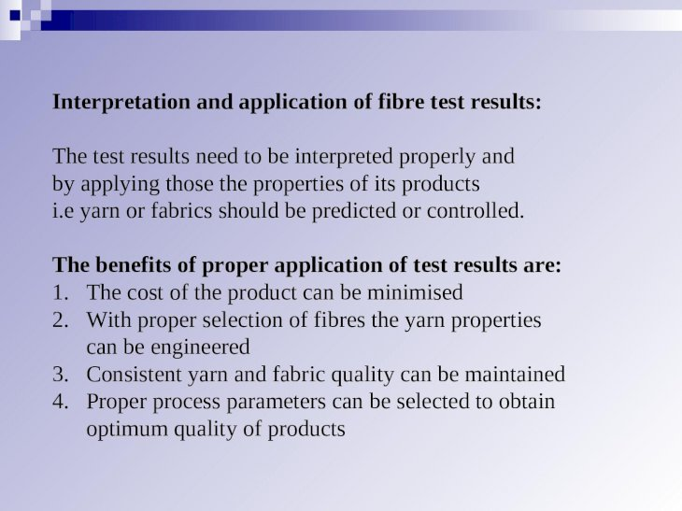

Slide 10
FIBER TESTING
The unit from which many complicated textile structures are built is the single fibre.
To evaluate the quality of raw material, two important dimensions namely fiber length and fineness are required.

Slide 11
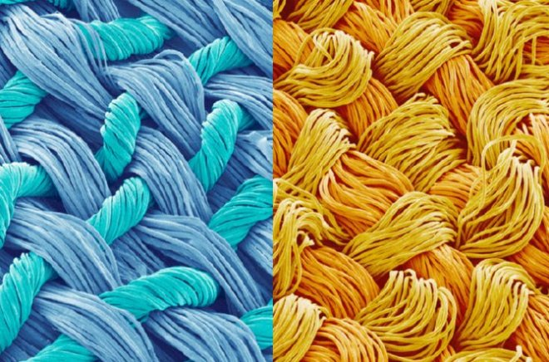
Importance Tests for Fibre Properties:
Fibre Length
Fibre Fineness
Fibre Maturity
Fibre Strength
Trash Content

Slide 12
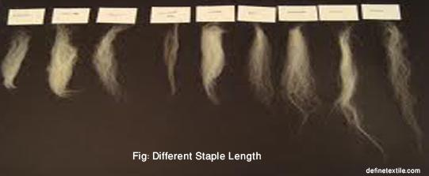
Fibre Length
Length of staple fibre is one of the most important characteristics.
The length and fineness are sometimes related in natural fibres whereas for manmade fibres, length and fineness can be controlled separately.
The measurement of natural fibres is a task as there is a greater variation in the length of different types of same material or within the same type
The properties of cotton fibre vary
For different growth areas.
For different climatic conditions.
From year to year.

Slide 13
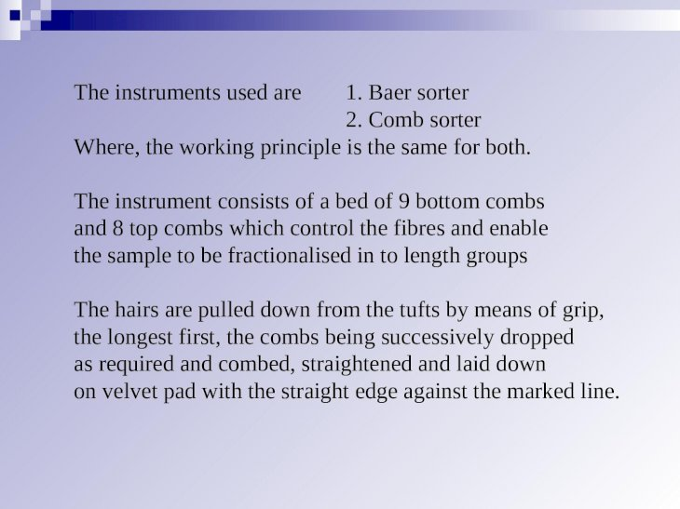

Slide 14
BAER SORTER
It is a comb sorter instrument which enables the sample to be fractionalized into small length groups.
PRINCIPLE:
a numerical sample of fibres is arranged in the form of an array in the descending order of length and from a tracing of this array the effective length, mean length, percentage of short fibers and dispersion are calculated.
The operation involves the following four main steps:
The preparation of a tuft with all the fibers aligned at one end.
The withdrawal of fibers in the order of decreasing length
The preparation of sorter diagram by laying the fibers on a black velvet pad in decreasing order of length , the fibers parallel and their lower ends aligned horizontal base line.
The analysis of the diagram

Slide 15
DESCRIPTION:
The baer sorter consist of a bed of combs which control and enable the sample of the fibers to be fractionalized into length groups.
The baer sorter has 12 bottom combs place in between a U shaped metallic frame .
All the bottom combs are hinged at one end and are supported by a rod, extending the width of the frame at the other end.
The rod can be moved from its position and when it is drawn the rod can be dropped one by one .
The needles of the bottom combs are pointing upwards and in between the bottom combs three top combs are placed.
The space between the two combs is ¼ inch except the first two bottom combs which will be 3/16 inch apart.
The top comber when placed in between the two bottom combs the distance between them will be 1/8 inch.

Slide 16
PROCEDURE
A representative sample of cotton is made into a sliver by drawing and doubling several times with the fibers straightened and parallelized.
The bundle of fibers must be as narrow as possible throughout the whole process .
The method of sorting is as follows:
The sorter is placed when the back facing the operator. The prepared sample is a slightly twisted and placed on the bottom combs at the right hand side of the sorter with a small tuft protruding.
From the protruding end, all the loose fibers are removed by means of the tweezer until the ends are aligned. The removed loose fibers are kept separately and introduced in the original sample later.

Slide 17
A tuft fibers are pulled out, combed and transferred to the left hand side of the sorter so that the comb nearest to the operator forms the starting line of the tuft, while at the other end the longest fiber protrude out. This tuft is pressed into the combs by means of the depressor.
This process is repeated till all the fibers on the right side, all combings are transferred to the left hand side.
The top combs are inserted in their position to grip and to control the slippage of the fibers.
The sorter is then turned round so that the front faces the operator
The bottom combs are dropped one by one successively till the tips of the longest fibers are seen.
The fibers are pulled by the tweezer, combed, straightened and laid perpendicular to a base line on a black velvet pad. When these fibers are exhausted, one more comb is dropped and the fiber next in order of the length are similarly pulled out and laid on the pad, all the fibers being carefully spread out to uniform density . The process is continued until the tuft is exhausted and the fiber array is obtained.

Slide 18
After the pattern is built up transparent scale with one side of the rectangle marked with 1/8 inch lines and the other side marked with ¼ inch lines is placed over the pattern.
Reading on the transparent scale the values of the coordinates are marked on a graph sheet and the pattern is drawn. The diagram is called Sorter diagram.
This diagram is analyzed for the following fiber particulars:
Effective Length
Mean length
Modal length
Percentage of shirt fibers
Dispersion

Slide 19
HAND STAPLING METHOD
A tuft of cotton of convenient size is taken and held it firmly between the thumb and the forefinger of each hand with the thumbs placed together.
The fingers being turned in towards the palms of the hands and the middle joints of the second, third and fourth fingers of each hand touching the corresponding joints of the fingers to give a good leverage for breaking the cotton.
The cotton is pulled slowly with about the same leverage of each hand on the joints of the fingers to separate the tuft of cotton into two parts.
The cotton remaining in the right hand is discarded
The distance between the two well defined edges on the tuft, where the density of the tuft changes most rapidly, is measured.
This is called the staple length of cotton

Slide 20
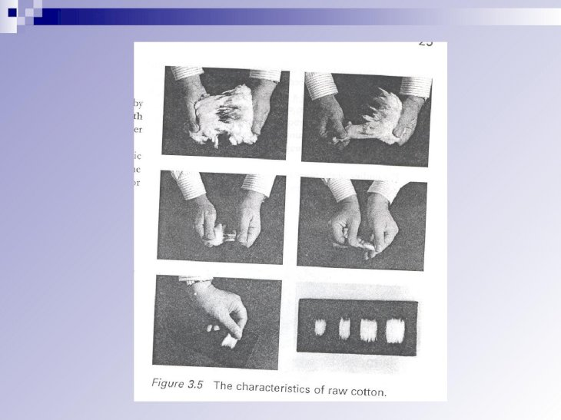
HAND STAPLING METHOD

Slide 21
Fibre Fineness
The following methods are used to measure the fineness of cotton fibre.
Gravimetric method
Optical method
Unidimensional method
Bidimensional method
Air flow method

Slide 22
AIR FLOW METHOD
The principle of air flow is the simplest method for measuring the fineness .
A sample of known weight is compressed in a cylinder to a known volume and subjected to an air current at known pressure.
The rate of air flow through porous plug of fibre is measured, flow meter often being calibrated in terms of fineness instead of volume per unit time.
Example microns for wool and micrograms per inch for cotton.

Slide 23
MICRONAIRE
Micronaire is an instrument based on the airflow principle
This is originally developed to estimate the fibre fineness in terms of micrograms per inch for cotton, the values so determined become known as Micronaire values.
This is a standard term referred for all types of cotton in order to grade.
However the Micronaire value do not signify only the fineness value.
It is an integrated value of both fineness and maturity when used for cotton fibres.
PRINCIPLE:
The rate of air flow is inversely proportional to the surface area of the fibers.
A sample of known weight is compressed in a cylinder to a known volume and subjected to an air current at a known pressure.
The rate of airflow through this porous plug of fibers, related to the fineness of the cotton fibre, is measured.

Slide 24
TESTING PROCEDURE:
50 grains (3.24 gms) of the samples is taken, weighing in a precision balance.
The sample is opened very well into a fluff and all the knotty balls and stringy sections are taken out and the fibers are separated and randomized individually.
The sample is introduced into the compression chamber.
The fiber compression plunger is inserted and locked in its place by twisting. This compresses the sample into a porous plug of fibre of 1 inch diameter and 1 inch length
The foot pedal is operated to allow air inside and the reading is taken with the top level of the float.
The foot pedal is operated to shut off the air flow. Then the fibre sample is removed from the compression chamber by operating the foot pedal.
The specimen is opened out and repacked into the fibre compression chamber and the above procedure is repeated.
Two samples should be tested from each test lot and the average value is calculated to the nearest 0.1 Micronaire unit.

Slide 25
After getting the Micronaire value the sample can be graded as given in the table.
FIBER FINENESS RATING
MICROGARMS PER INCH RATING
Below 3 Very fine
3 to 3.9 Fine
4 to 4.9 Average fine
5 to 5.9 Coarse
6 and above Very coarse

Slide 26
FIBRE MATURITY
Methods of determination of maturity:
Several methods are available for determining the maturity of cotton. These can be grouped as follows.
Direct method – caustic soda swelling method
Indirect method
a) Differential dyeing method
b) Caustic caire method
c) Polarized light method

Slide 27
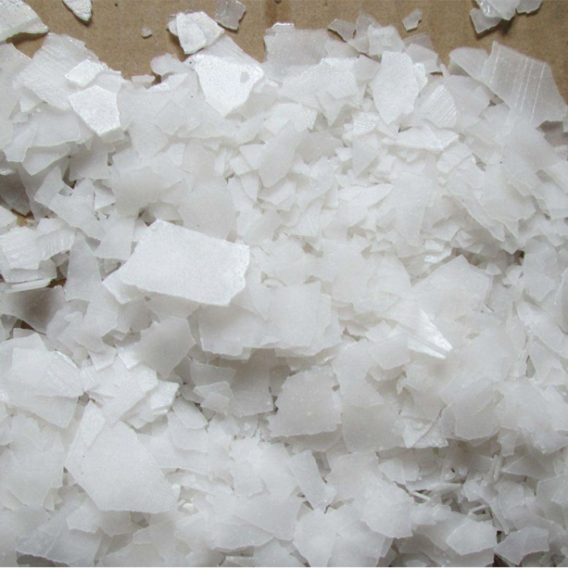
CAUSTIC SODA SWELLING METHOD
It is the most commonly used method a thin tuft of fibers is drawn by means of tweezers from a sliver held in a comb sorter.
The tuft is laid on a microscope slide, the fibers are parallel and separated and a cover clip is put over the middle.
Likewise four to eight slides are prepared.
There are two steps involved in this method
Treatment with 18% caustic soda
Examination under a microscope to count the mature, half mature and immature fibers.

Slide 28
The fibers on the microscopic slide are then irrigated with a small amount of 18% caustic soda solution, which has the effect of swelling them.
The slide is then placed on a stage of a microscope and examined.
The presence or absence of convolution is observed and the fibers are classified into three groups.
a) Mature or normal fibers
b) Half mature or thin walled fibers
c) Immature or dead fibers.
The presence of caustic soda changes the appearance of both mature and immature fibers by swelling.
Mature fibers with a well developed cell wall and pronounce convolution in the raw state become rod like after swelling.
These rod like fibers are classed as normal or mature fibers.
In this case the lumen is practically absent. Dead or immature fiber appear ribbon like even after swelling.
In dead fibers the wall thickness is less than 1/5 of the ribbon width.
Thin walled or half mature fibers are those lying between the other two classes.

Slide 29
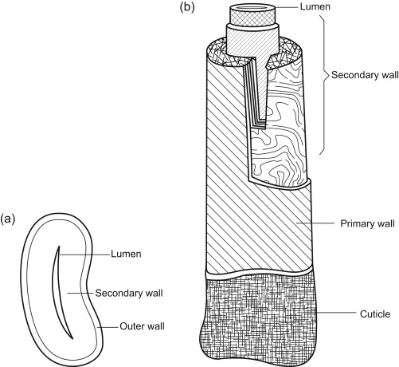
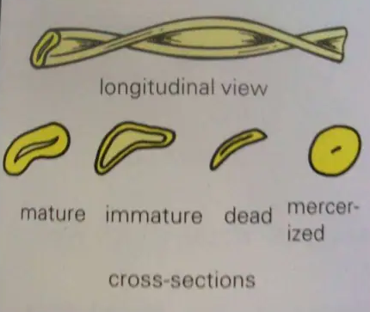
The fibers are classed as above based on the ratio of lumen width (L) to wall thickness (W) as indicated below.
CLASS RATIO OF LUMEN WIDTH TO WALLTHICKNESS
Mature less than 1
Half mature 1 -2
Immature Greater than 2

Slide 30
All the sides are examined as above and the percentage of mature (N) half mature (H) and immature (I) fibers are calculated.
Then the maturity of the cotton fiber is expressed by one of the following terms.
Percentage of mature fibers (N)
Maturity ratio, (M)
Maturity co-efficient (Mc)
a) Percentage Of Mature Fibers
Knowing the total number of fibers examined and the number of mature fibers the percentage of mature fiber can be calculated as
%of mature fibers N = Number of mature fibers x 100
Total no of fibers examined

Slide 31
FIBER STRENGTH
Fiber strength is generally considered to be next to fiber length and fineness in the order of importance amongst the fiber properties.
For cotton beyond a certain staple length, this property assumes greater significance.
The following are the units and the terms employed for reporting fiber strength.
Load 7) strain
Breaking load 8) extension
Stress 9) The load elongation
Mass stress 10) stress strain curve
Tenacity
Breaking length

Slide 32
PRESSLEY TESTER
  WORKING:
  The heavy rolling weight is initially help in a position by a catch.
  Then the prepared clamps are inserted into the grooves in the clamping block and the catch is released.
  As the weight moves away from the beam pivot the end B of the beam rises which moves the upper clamp upwards and away from the fixed lower clamp.
  Therefore a force will be exerted on the ribbon of fibers and breaks it.
  As soon as the ribbon breaks the beam drops and a breaking device causes the rolling weight to be stopped instantly.
  The distance travelled by the rolling weight is a measure of the load required to break the specimen and is noted down from the scale calibrated on the beam.
  The clamps are then removed from the tester two halves of the broken specimen are collected and weighed on torsion balance in mg.
  From the breaking load of fibers in pounds and the weight in mg the calculations can be made.

Slide 33
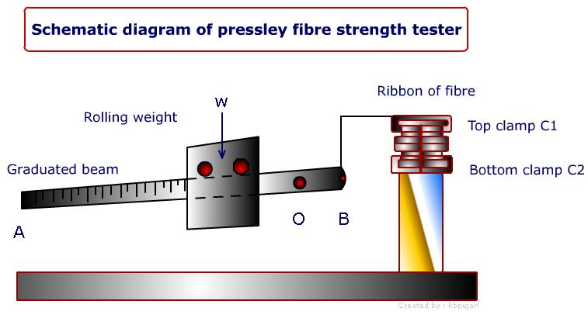

Slide 34
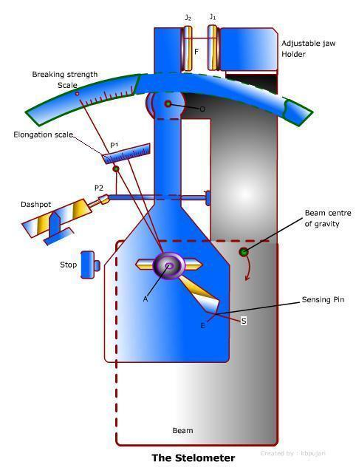
STELOMETER

Slide 35
Capable of measuring strength as well as elongation of fibre bundle.
Works with Pendulum lever principle .
The loading of the specimen is carried out by a pendulum system, which is mounted in such a way that it rotates about its C.G.
It eliminates the inertia effects associated with normal pendulum principle.
The beam and pendulum start in a vertical position but the C.G. of beam is such that when it is released the whole assembly rotates.
The speed of rotation is controlled by adjusting the dashpot.

Slide 36
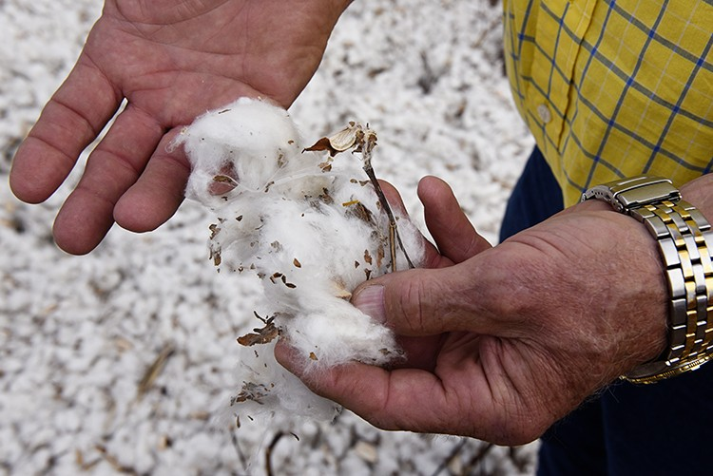
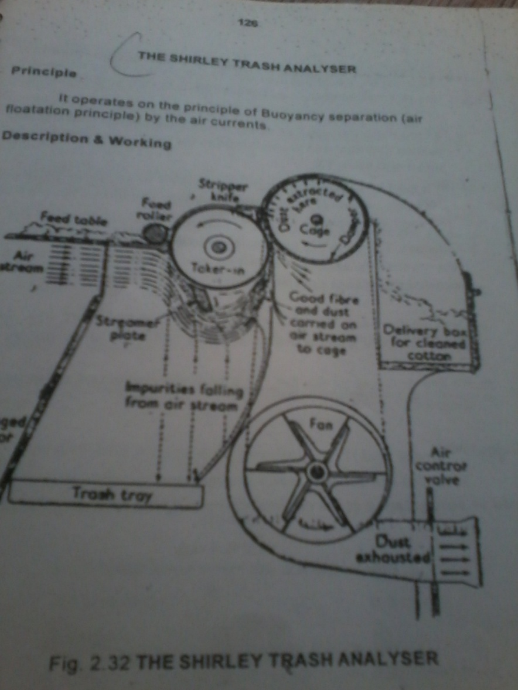
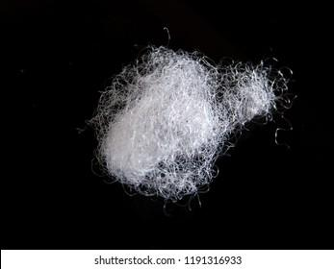
SHIRLEY TRASH ANALYZER
Trash
Lint

Slide 37
Introduction:
The measurement of trash or non-lint content is very important in assessing the lint quality of cotton sample .
It provides an effective means for both quantitative and qualitative analyses of foreign matter in cotton lint .
The Shirley Analyser separates the trash from the lint with a minimum of fiber loss . This is probably the nearest approach to perfect separation of lint and foreign matter that has yet been developed.
Parameters Tested:
Lint content(L) in weight and percentage
Trash content(T) in weight and percentage
Invisible waste(W) in weight and percentage
Features:
Compact , aerodynamic shape , silent operation and non-polluting nature boosts laboratory environment
Digital , monitor based and user friendly operating system
Solid-state controlled electrical system to enhance operator safety

Slide 38
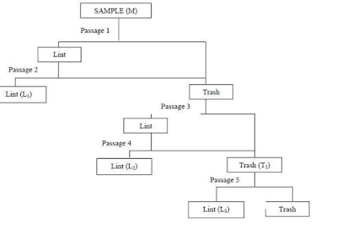
Working Principle:
The Shirley Analyser works on the principle of buoyancy separation (air flotation principle) by air currents .
The Shirley analyzer consists of a feed roller, licker- in, the cylinder and a blower to open the fibers and separate lint and trash.
The cotton is fed slowly to the licker-in and, as it is broken up, the air blast carries the lint around the bottom of the flow plate and up to the condenser.
Trash and heavy particles drop into the waste chamber.
The machine is so constructed that not only raw cotton but also various waste products can be analyzed.
The working is similar that of a miniature carding machine.

Slide 39
Procedure
Clean the instrument and the containers
Shake the specimen so that large particles of foreign matter i.e. husk , leaves , stem particles, metal particles etc (which may otherwise damage the machine) are removed from the specimen. Keep these droppings separately.
Open out the hard lumps of fibers, if present
Spread the specimen on the feed plate in the form of an even layer
Start the machine and let the trash and lint collect in their respective compartments
Take out the lint from the lint chamber and pass it again through the machine without disturbing the discarded matter in the settling chamber
Stop the machine and collect the lint (L1) from the lint chamber and keep it in a separate container
Remove all the discarded particles containing lint from the tray and settling chamber and pass it through the machine.

Slide 40
Collect the lint (L2) and keep it in a separate chamber. Collect all the discarded matter (T1) in the tray, settling chamber and any seeds clinging to the wires of the licker– in the cylinder and combine them
Weigh the discarded matter (T1) (to an accuracy of 100 mg and if the weight is less than 10g, weight to an accuracy of 10 mg), which contains lint again through the machine and ignore the discarded matter collected . Collect the lint (L3) and keep it in a separate container. Weigh the lint (L3) to an accuracy of 10 mg
Combine all the portions of lint (L1, L2, and L3) and weight to an accuracy of 10 mg.
Calculations:
Lint content (L)% = [(L1+ L2+ L3) ÷ M] × 100
Trash content (visible waste) (T)% = [(T1 – L3) ÷ M] × 100
Invisible waste content (W)% = 100 – (L+T)

Slide 41
YouTube links
Baer Sorter - https://youtu.be/bZfnKr0LSAo
Hand stapling method - https://youtu.be/3az0eyj3w2Y
Air Flow Method - https://youtu.be/s3C4-jRZ0m4
Pressley Tester - https://youtu.be/Hj4a8RAHnOs
Stelometer - https://youtu.be/qwT_vVWTC6A
Shirley trash analyzer - https://youtu.be/-n5SsKs7Q4w

