Slide 1
TEXTILE TESTING

Slide 2
INTRODUCTION
Next of food and shelter, clothing is the most important need of mankind.
In modern trends its utility for enhancing the appearance of an individual could be considered equally important.
Also some type of fabrics are used for different types of industrial purpose.
In order to judge the suitability of a fabric for different end uses such as clothing, industrial appliances etc.,

Slide 3
FABRIC PARTICULARS
Fabrics are tested for the following quality particulars.
1)Dimensional Characteristics
a) Length b) Width c)Thickness
2)Threads per inch
a) Ends per inch b) Picks per inch
3)Count
a) Warp count b) Weft count
4)Weight of the fabric
a)Weight per unit area b)Weight per unit length

Slide 4
5) Crimp
a) Warp crimp b) Weft crimp
6) Strength
a)Tensile strength b)Tearing strength
c) Bursting strength
7)Abrasion resistance
8) Handle

Slide 5
Fabric length
Fabric length is the distance from end to end, along the selvedge of a fabric.
The sample is conditioned in the standard atmosphere and testing is carried out.
The strains imposed during manufacturing and finishing may appreciably affect the length of the fabric and some recovery may take place during storage.
ISI suggests the following three methods
By using a measuring table
By using a measuring scale
By using a measuring machine

Slide 6
Fabric width
The width of the fabric is measured after conditioning them in the standard testing atmosphere.
Fabric width is the distance from the outside of one selvedge to the outside of the other, measured perpendicular to the length of the fabric.
The cloth is laid on a smooth flat measuring table without applying more tension. The tension applied must be just sufficient to keep the fabric straight and flat.
Then a measuring scale is placed at right angles to the selvedge, the width of the fabric is measured correct to 1mm. The width is measured at five different places and the average value is taken.
To nearest 1mm for width upto 50 cm
To nearest 5 mm for width upto 100 cm
To nearest 10mm for width over 100cm
In case of fabrics including narrow width fabrics with irregular selvedge, atleast two readings should be taken.

Slide 7
FABRIC CRIMP
1)Due to the interlacing of warp and weft threads a certain amount of waviness is imparted to the warp and weft threads in a fabric. This is called crimp.
2) Hence the apparent length of a thread as it exists in the fabric is less than its straightened length.
SPECIMEN PREPARATION:
Rectangular strips are carefully marked on the cloth and each strip is cut in the form of a flap.
From each stripm10 threads will be removed.
3 strips in warp way and 3 strips in weft way are cut.

Slide 8
The instrument consist of a scale fixed on the base.
At one end of the base, V groove are provided to support the balancing head and a mirror at the other end.
At one end of the balancing head a fixed clamp is provided and at its other end on the frame, index lines are marked.
Another movable clamp is provided on the base and can be slided over the scale.
Tension weight is provided on the balancing head to change the tension according to the yarn count.
Tension scale is marked in two ranges.

Slide 9
FABRIC WEIGHT
The weight of the fabric can be determined in the following two ways
1. Weight per unit area in terms of ounces per square yard or grams per sq.mtr.
2. Weight per unit length interms of ounces per yard or grams per meter.
FIRST METHOD:
Weighting of the entire cut / roll/ bale when the length and width of the fabric are known using the formulae.
Weight per unit area = 576 M/LW oz/sq.yd M=weight, L= Length, W= width
Weight per unit length = 16 M/L oz/sq.yd
SECOND METHOD:
weighting of 1 yard length of fabric . This weight is called as weight per running yard. The weight of a unit length of fabric will be affected by its width. There fore it is necessary to know the agreed standards width upon which the weight per running yard is based.
THIRD METHOD:
weighting of the specimen using a quadrant balance

Slide 10
COVER FACTOR
It is defined as the fraction of the area of the fabric covered by both warp and weft yarns.
It is calculated from the threads / inch in the fabric and counts of the threads.
CLOTH SETTING:
it gives the density of thread spacing and is expressed as the number of threads over a convenient linear distance such as inch or a centimeter.
Two values are important the first defining the number of ends, the second the number of picks per unit space to express the cloth setting.

Slide 11
FABRIC STRENGTH
Testing of fabric becomes essential because of the following reason.
To check the fabric for specifications
To note the change in the structural details
To note the change in the physical and chemical treatments, exposure to weather, laundering etc.,
To check the probable performance in its use
To design the fabric for specific purpose

Slide 12
FABRIC TENSILE STRENGTH
The breaking strength is a measure of the resistance of the fabric to a tensile load or stress in either warp or weft direction.
To measure the breaking strength there are three tests that may be used. They are
Raveling strip method
cut strip method
Grap method

Slide 13
RAVELLED STRIP METHOD:
It is a tension test on a strip of fabric in which the specified specimen width is secured by raveling away yarns.
The specimen should be of width 2 inches and 8 inches test length.
For this samples of 12 inches x 2 ½ inches are cut.
The extra length is allowed for gripping in the jaws.
From these samples threads from both the edges are removed until the width is reduced to 2 inches exactly.
Rate of traverse of bottom clamp is 12 inches / minute.

Slide 14
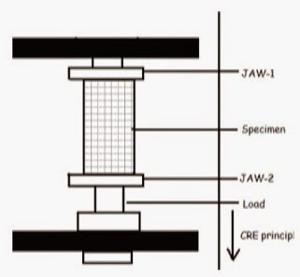
CUT STRIP METHOD
It is a tension test on a strip of fabric in which the specimen width is secured by cutting the fabric.
This method is identical to ravelled strip method
The sample with is 2 inches and length is 8 inches exactly and no ravelling is needed.
This method is used for coated and heavily sized fabrics.

Slide 15
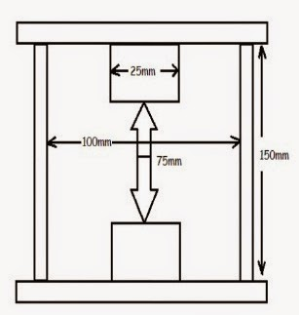
GRAB TEST

Slide 16
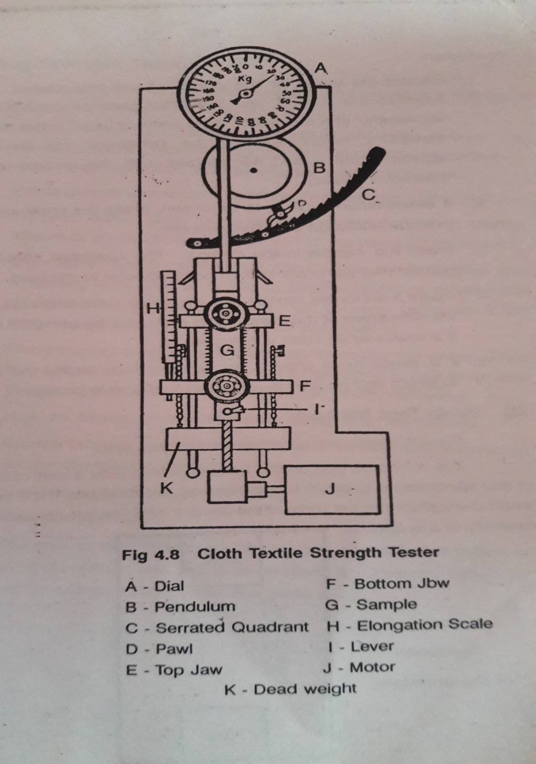
TENSILE STRENGTH TESTER
.

Slide 17
TENSILE STRENGTH TESTER
This is a motor driven pendulum type strength tester.
A dial plate is calibrated in kgs and lbs is provided at the top and a pointer is made to move over the dial plate.
The pointer shaft is connected to the upper clamp by connecting rod and a steel tape against a heavy pendulum.
The pendulum carries a pawl which moves over a toothed quadrant.
This acts as a catch and prevents the heavy pendulum from dropping back after the breakage of the material takes place.
This also helps to note the reading.
A red pointer is provided in the upper clamp and an elongation scale in the lower clamp to note the elongation specimen.
Downward movement is given to the lower clamp by a screw rod and a lever at the rate of 18 inches / minute.
A catch is provided for the upper clamp to mount the sample without disturbing the pointer on the dial.

Slide 18
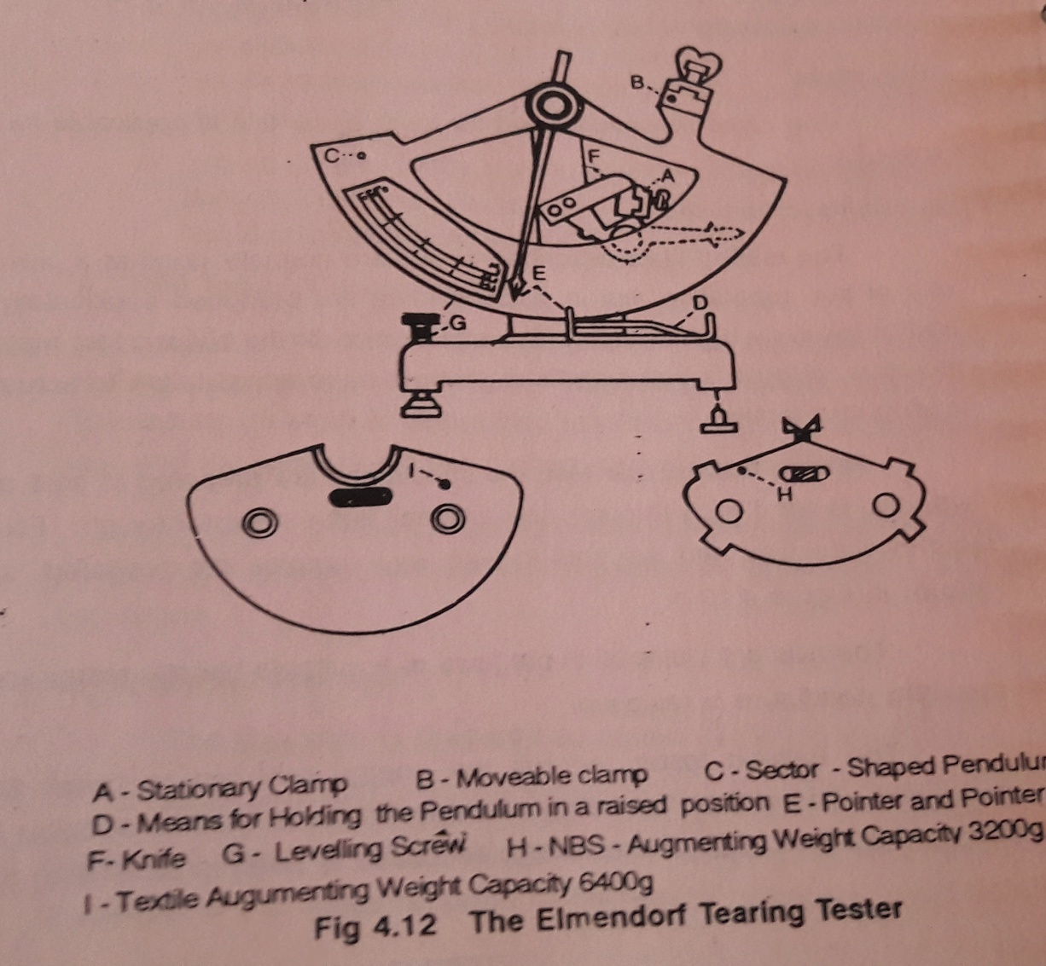
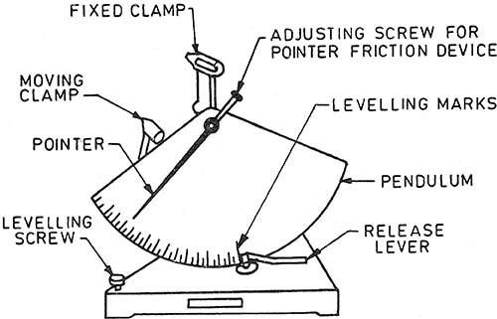
TEARING STRENGTH TESTER

Slide 19
TEARING STRENGTH TESTER
The instrument is leveled and adjusted to zero.
The capacity of the instrument is selected so that the specimen tears between 20 and 60 percent.
The pendulum is raised to the starting position and the pointer is set against its stop.
The conditioned test specimen is fixed in the clamps so that it is well centered, with bottom edge set against the marks and the upper edge parallel to the top of the clamps. The clamps are tightened.
If the slit has not been cut by the die, using the knife, a 20 mm slit is cut in specimen.
The pendulum is released by depressing the pendulum stop.

Slide 20
The stop is held down until after the tear is completed and the pendulum is caught on the return swing by the hand without disturbing the position of the pointer.
The above procedure is repeated for all the test specimens and the average tearing force is calculated.
Tearing = Capacity of instrument X Pointer reading
strength 100
in gms

Slide 21
HYDRAULIC BURSTING TESTER
The pressure in a liquid is exerted in all directions and this phenomenon of a liquid is used for testing bursting stregth in hydraulic bursting strength tester.
The specimen is clamped by a ring over a thin flexible diaphragm.
This diaphragm is clamped over a circular hole in the upper face of a reservoir.
The liquid used may be water or glycerine.
The pressure in the liquid is increased by valves.
Due to increase in pressure the diaphragm bulges with it the specimen.
At some point the fabric bursts and the pressure at the point is indicated by the pressure gauge

Slide 22
Diaphragm bursting test:
In this test the fabric sample is clamped over a rubber diaphragm by means of an annular clamping ring.
An increasing fluid pressure is applied to the underside of the diaphragm until the specimen bursts.
The operating fluid may be a liquid or a gas.
Sample:
Specimens of two sizes are used; 30mm and 113mm.
The specimen with the larger diameter fails at lower pressure (approximately 1/5 of the 30mm diameter value).
The standard requires 10 specimens to be tested.
Procedure: The fabric sample is clamped over the rubber diaphragm.
The pressure in the fluid increases at such a rate that the specimen bursts within 20 ± 3 sec. (P₁).
The height (extension) of the diaphragm is noted
Another test is carried out without a specimen.
The pressure to do this is noted and then deducted from the earlier reading.
(P₁ - P₂) is the actual bursting strength of the specimen.
Mean bursting strength “kN/m²”

Slide 23
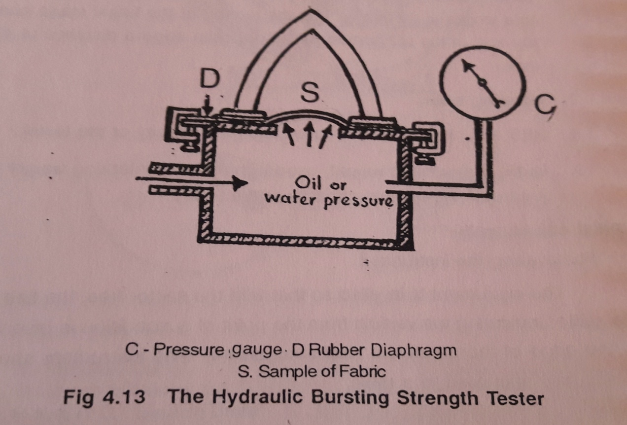

Slide 24
FABRIC ABRASION
Abrasion Resistance:
Abrasion is the rubbing away of the component fibres and yarns of the fabric.
Abrasion is of three types :
Plain or flat abrasion - A flat area of material is abraded.
Edge abrasion - Kind of abrasion which occurs at collars and folds.
Flex abrasion - Rubbing is accompanied by flexing and bending

Slide 25
FABRIC ABRASION
SERVICEABILITY:
To decide about the suitability of the end use for the fiber, yarn or fabric.
To compare a number of different fibers, yarns or fabrics.
To determine the effect of cloth structure and finishing on the performance of fabric.
To determine the suitability of the fabric for the particular end use.
WEAR:
wear is the amount of deterioration of a fabric due to breaking, cutting or removal of the fibers. It is the net result of a number of agencies which reduce the serviceability of an article.

Slide 26
ABRASION RESISTANCE:
The following points require consideration in abrasion resistance testing.
Condition of specimen
Choice of testing instrument – flat or flexing method
Choice of abrasion motion- rubbing movement
Direction of abrasion – warp, weft , un idirection
Choice of abradant – steel, silicon carbide will give constant abrasive qualities.
Backing of the specimen – hardness if the backing material can effect the result.
Cleanliness of the specimen and the instrument –abrading region should be handles minimum. Free from foreign matters – wax, graphite, etc.,

Slide 27
8. Tension of the specimen
9. The pressure between specimen and the abradant.
10.End point test.
ASSESSMENT:
Comparison of abraded specimen with unabraded specimen
Cycles required to produce a hole broken thread
Loss in weight
Change in thickness
Loss in strength – tensile, tearing, bursting
Change in other properties – permeability, lusture
Microscopic examination of the damage.

Slide 28
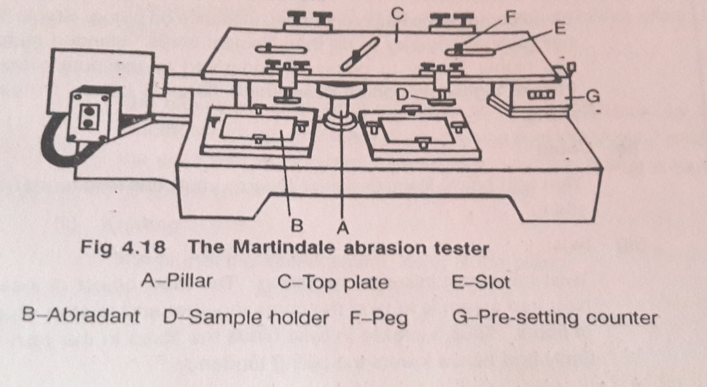
MARTINDALE ABRASION TESTER

Slide 29
It consist of top plate supported by three pillars.
On the top of each pillar is a caster.
These ball caster allows the plate to slide easily in the horizontal plane.
The driving arrangement for the plate consist of mechanical device of worm and worm wheel driving three circular cam disc.
On the cams pins are provided with bush bearings and pins engage the slot in the place.
The two outside pin work in two slots in the same line and the centre pin works in the slot at right angles.
As the cam disc carrying the pins rotate, they rotate the plate.
Hence the result of these two motions will be two simple harmonic motion at right angles.
The top plate also consist of four holes to carry the circular sample holder s and they can be clamped to the top plate.
4 specimens of 38mm diameter are cut and fixed on the sample holders.
The sample holders touch the table surface and it will be flat and will move in the same plane in which the top plate slides.

Slide 30
Because of this movement the cloth is rubbed against the cloth surface in harmonic pattern.
At one stage it will be circular and then changes to a curve of ellipse until the line becomes a straight line along the diagonal of the circle.
This type of motion has the advantage that the specimen will be rubbed in all portions . Both the warp and weft ways and this is superior to flax abrasion.
END POINT:
End point is determined either by visual examination by the appearance of holes for a known cycle or loss in weight of the sample for known cycles.

Slide 31
Pilling
A garment is considered to be serviceable when it is fit for its particular end use.
It is a fabric surface fault characterized by little pills of entangled fibre clinging to the cloth surface and giving the garment an unsightly appearance.
Formed by rubbing action on loose fibres that are present on the fabric surface.
Stronger component in the blend aggravated its seriousness.
Higher breaking strength and lower bending stiffness results more pill.
Low twist factor, higher hairiness, and loose fabric structure results easy and large pills (knitwear)

Slide 32
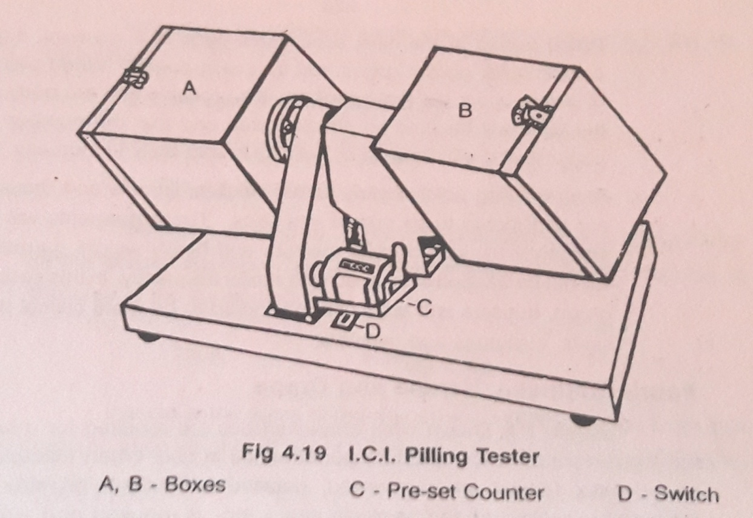
Measurement of fabric pilling:
a) Objective method: Counting the number of pills or by removing and weighting them.
Time consuming, also does not take into account the degree of colour contrast with the ground.
b) Subjective method: By comparing it with either standard sample or with photograph or by the use of a written scale of severity.

Slide 33
I C I PILL BOX TSETER
A piece of fabric measuring 5 x 5 inch is stitches so as to be a firm fit when placed round a rubber tube in 1 ¼ inch outside dia.
The cut ends of the fabric are covered by cellophane tape.
Four such tubes are placed in a box (9 x 9 x 9 inch).
The box is then rotated at 60 rpm for 5 hrs.
For garments which are normally subjected to repeated washing as well as to wear washing may be done prior to sample preparation.
After the test is over the extent of pilling is assessed visually by comparison with the arbitary standards 1, 2 and 3.
Under test conditions fabrics of
standard 1 become hairy but do not pill
standard 2 become hairy and pills lightly
standard 3 becomes hairy and pills more severely.

Slide 34
DRAPE METER
A circular specimen of diameter 10inches is supported on a circular disc of diameter 5 inches.
When doing so the unsupported area of the fabric drapes over the edge of the supporting disc.
If the specimen is a solid say a cardboard draping would not occur and hence the area of projection from the periphery would equal to the area of the solid object.
When the fabric is supported , it will assume the folded configuration due to gravity and the shape of the projected area will not be circular.
Measuring the following areas, the drape co –efficient F1, can be calculated
a) The area of the specimen, AD
b) The area of supporting disc Ad
c) The actual projected area of the specimen As

Slide 35
The drape co-efficient F is the ratio between the projected area of the draped specimen and its unsupported area, after the deduction of the area of the supporting disc.
Thus F = As - Ad / AD – Ad
Instead of the areas of the draped and undraped specimen their corresponding weights of paper projection can also be taken to calculate the drape co – efficient.
F = Ws - Wd / WD - Ad.
WD – weight of the paper whose area is equal to the specimen.
Wd – Weight of the paper whose area is equal supporting disc.
Ws – weight of the paper whose area is equal to the projected area of the specimen.

Slide 36
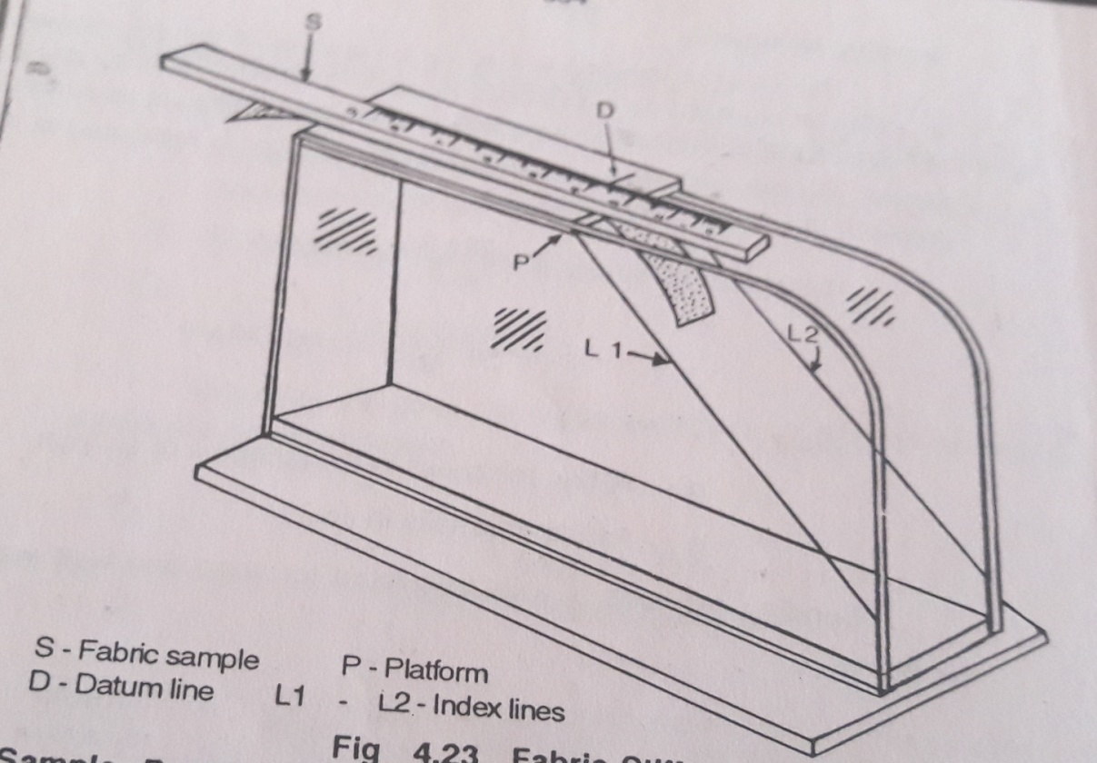
FABRIC STIFFNESS TESTER

Slide 37
SHIRLEY STIFFNESS TESTER
The test is carried out in the standard testing atmosphere.
The tester is set on a table so that the horizontal platform and the index lines are at eye level.
The specimen is placed on the platform with the template at the top of it so that the leading edges coincide.
Both are slowly pushed forward until the leading edge is taken.
For the specimens which twist 45 degree.
Then the bending length can be read from the scale opposite to datum line.
Four readings are taken from each specimen, with each side up first at one end and then the other.

Slide 38
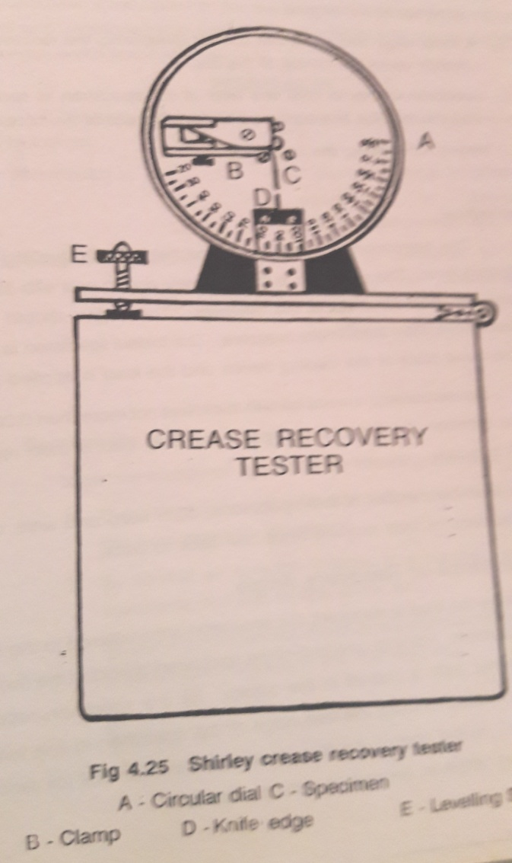
CREASE RECOVERY TESTER

Slide 39
CREASE RESISTANCE TESTER
The instrument is levelled with the help of the levelling screw and spirit level.
The specimen is folded gently end to end with its edges in one line with the help of the tweezers.
The edges should not be gripped more than 5 mm in the tweezers.
The folded specimen is placed on the lower plate of the loading device and the load is applied gently.
Before loading a metal foil with thickness not more than 0.02 mm is placed between the limbs of the specimen.
The load is then removed after 5 minutes.
Half the number of specimens both warp and weft should be folded face to face and the other half back to back.

Slide 40
CREASE RECOVERY TESTER
After the load is removed the specimen is transferred to the clamp of the instrument.
For this one limb of the specimen is hold in the tweezers and the other limb is placed in the clamp.
As the specimen recovers the dial is rotated to keep the free edge of the specimen in line with the knife edge .
At the end of the time period (5 min) allowed for recovery the recovery angle in degrees is read on the dial.
The above procedure is repeated for all the warp way and weft way specimens and the average recovery angle is calculated.

Slide 41
AIR PERMEABILITY
Air permeability of a fabric is the volume of air measured in cubic cm passed per second through 1 sq.cm. for the fabric at a pressure of one cm.

Slide 42
SHIRLEY AIR PERMEABILITY TESTER
The specimen is clamped and the suction pump is started keeping all the taps closed.
When the required pressure drop which is normally 1 cm of water is attained and the indicator of the draught gauge is steady, the rate of flow of air is read of one of the four rotameters.
Out of the four rotameters anyone can be selected according to the type of fabric.
The test is commenced with R4 open and others closed.
To prevent any damage to the draught gauge , due to any undue pressure drop across the fabric a sfety valve F is provided.

Slide 43
The area of the sample exposed for the test is 5.07 sq.cm 1 inch diameter circular fabric is exposed to air.
From the readings of the rotameter, air permeability and air resistance can be calculated using the following formulae.
Air permeability= Average rate of air flow/5.07
Air resistance = 5.07 / Average rate of air flow

Slide 44
WATER PERMEABILITY TEST
SPRAY TEST
In this test a small scale mock rain shower is produced by pouring water through a spray nozzle.
The water falls onto the specimen which is mounted over a 6inches diameter embroidery hoop and fixed at an angle of 45degree.
To carry out the test 250 cu.cm of water 27 plus or minus degrees are poured steadily into the funnel.
The distance from the bottom of the spray has finished, the sample holder is removed and the surplus water removed by tapping the frame six times against a solid object, with the face of the sample facing the solid object.
The assessment of the water repellency of the fabric is given by the spray rating.
After the removal of the surplus water is accomplished the fabric surface is examined visually by matching against the rating chart of photographs.

Slide 45
100 – no sticking or wetting of the upper surface
90 – slight random sticking or wetting of the upper surface
80 – wetting of upper surface at spray points
70 – partial wetting of whole of upper surface
50 – complete wetting of whole of upper surface
0 – complete wetting of whole of upper and lower surfaces.
Five test should be made and the mean is reported.

Slide 46
BUNDERSMANN TESTER
The fabric specimen are mounted over special cups or bezels and subjected to a shower of water from a multi nozzle drop producer.
Water which penetrates the fabric is collected in the bezels and measured.
The water which is retained by the specimen is also measured.
The shower producer is mounted 150 cm above the four bezels.
The bezels are mounted on an assembly rotating at 5 rpm.
As the fabric circulate in the shower of water special wipes inside the bezels rub the underside of the specimens in order to reproduce the rubbing action mechanically which occurs in practice.
After 10 minutes shower of controlled severity the specimens are removed and two values determined.
a) Penetration b) Absorption.

